Slide 1

Programming Learning App for Kids
R24-109

Slide 2

Research Problem
Sri Lanka is facing a USD price hike [1], impacting several sectors still recovering from the pandemic [2].
Fortunately, IT Sector is still good in Sri Lanka.
Increased outsourcing from larger companies to South Asian countries, primarily India, presents potential challenges [3].
India's large pool of young talent contributing to open-source projects is a potential competitor [4].
Potential knowledge gap between Sri Lankan Teenagers and Indian Teenagers.

Slide 3

Research Questions ?
How to provide a basic knowledge of programming to kids ?
How to evaluate and examine the kids ?
How to assist kids when they are getting doubts?
How effective is the machine learning model in analyzing students and assigning relevant projects?

Slide 4

Objectives
Main Objective
The primary research objective is to bridge the knowledge gap between our country's students and Indian students, with a focus on producing high-quality and knowledgeable engineers.
Sub Objectives
Exploratory Analysis of Interactive Programming Concepts for Learning
Evaluation and Grading Mechanism Analysis
Assist kids through a Customized Kids Assistance System.
Teach kids how to progress by a Project-based Programming System.

Slide 5
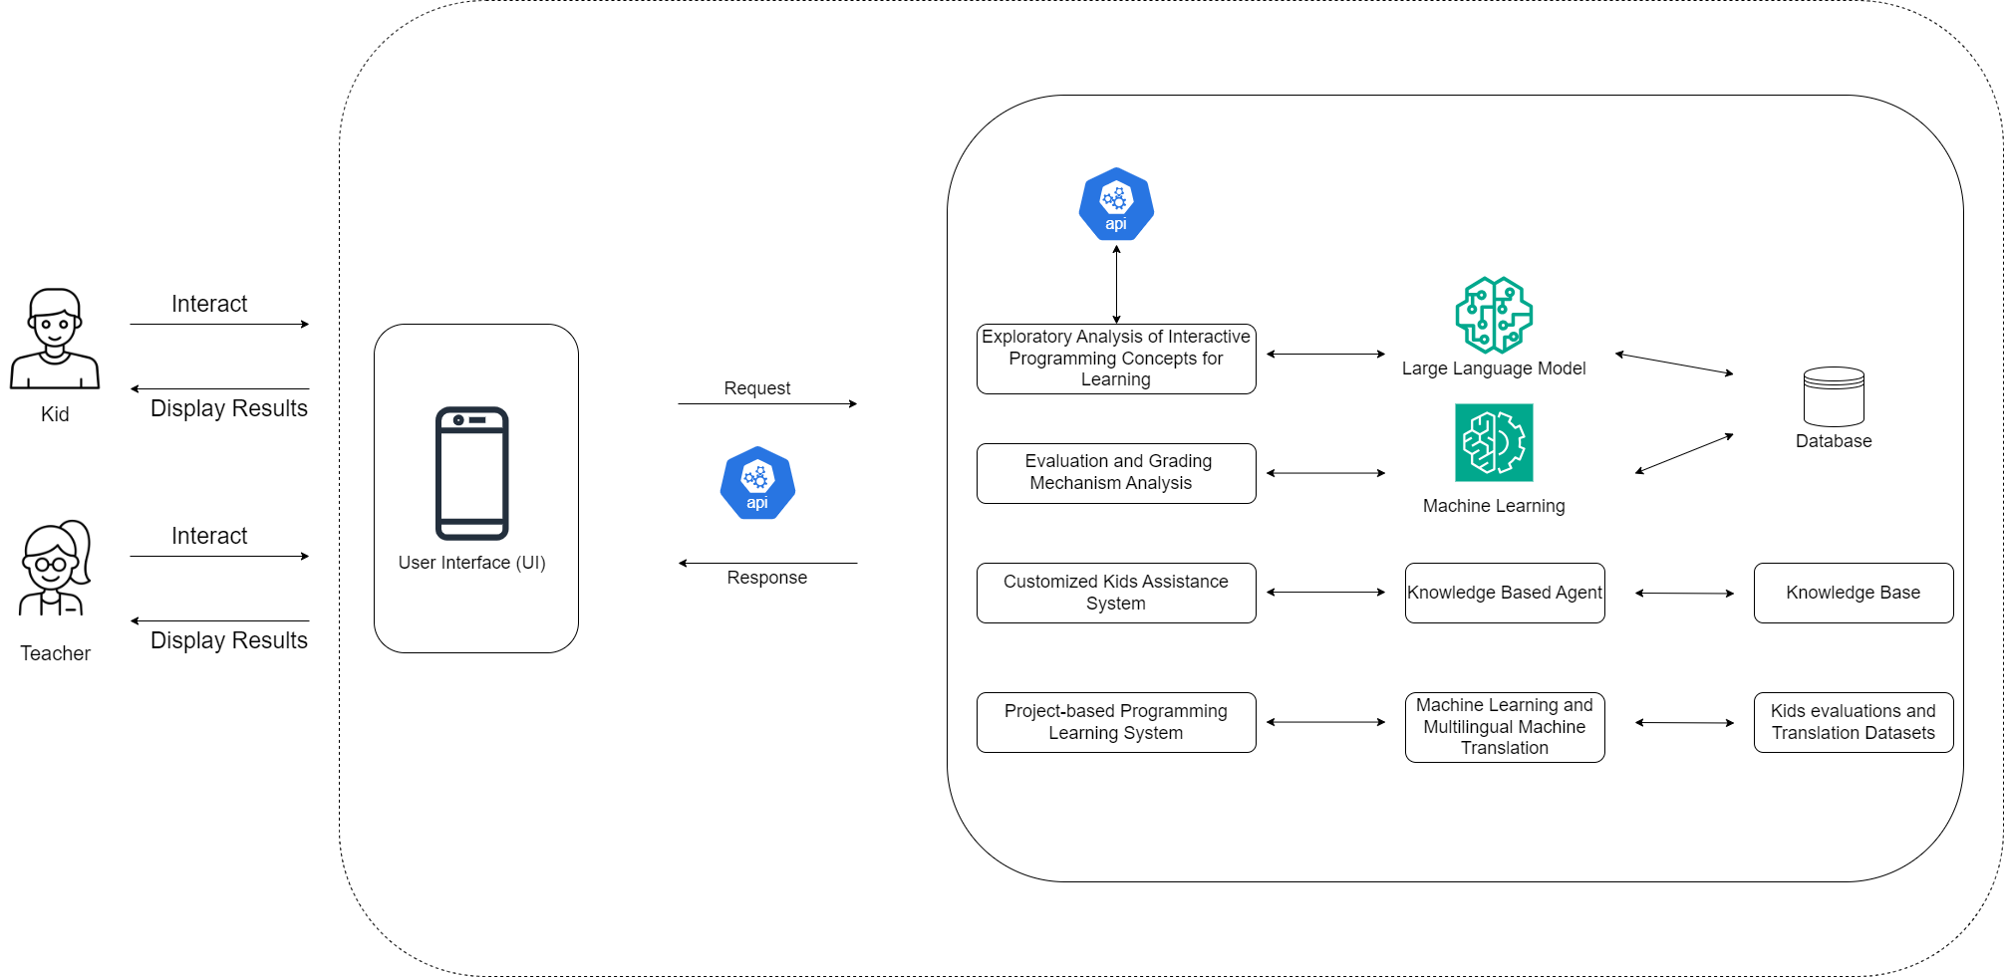
System Diagram

Slide 6

Personalized Story Generation IT21023446 | Sanjeevan m.c.m.a
Software Engineering Specialization
IT21023446 | Sanjeevan M.C.M.A | R24-109

Slide 7






Research Question
Does an interactive mobile application utilizing storytelling and gamification techniques effectively enhance children's understanding of fundamental programming concepts in the learner's native language compared to traditional learning methods?
IT21023446 | Sanjeevan M.C.M.A | R24-109

Slide 8
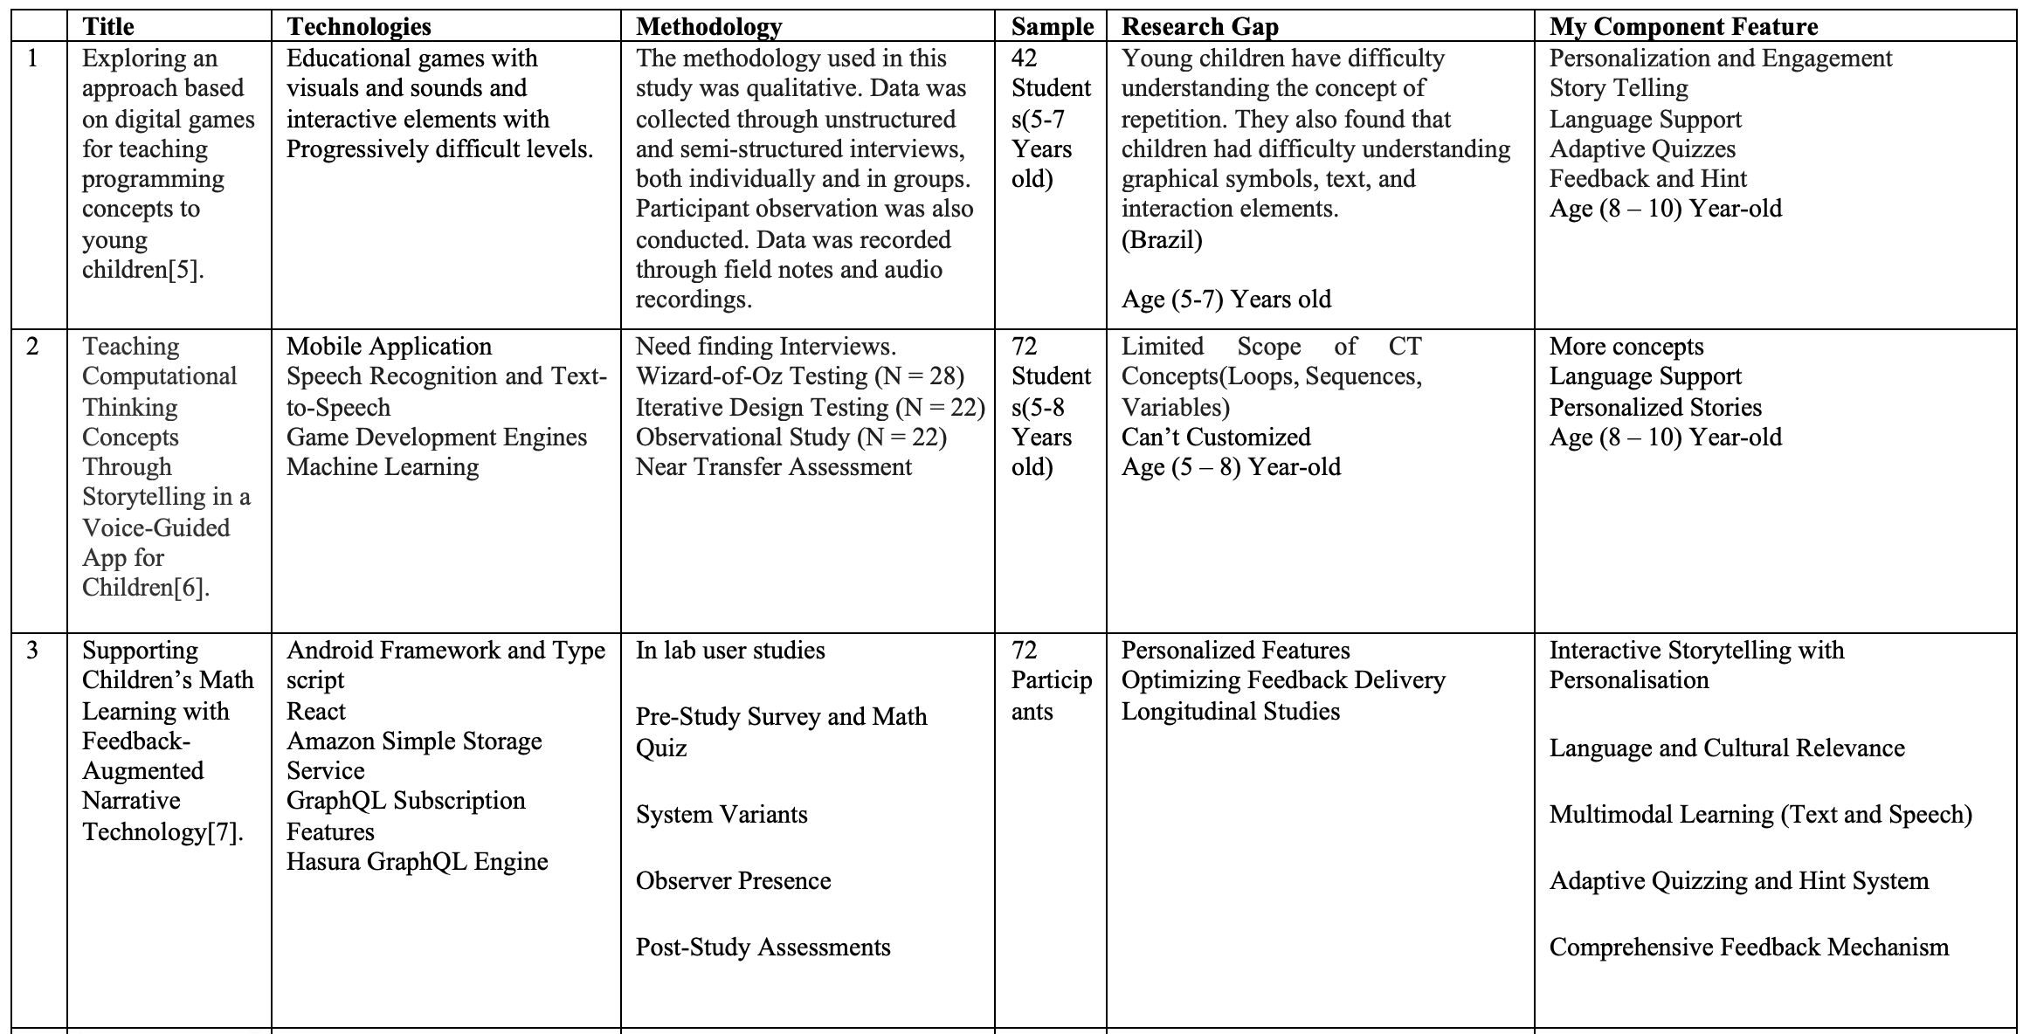
Research Gap
IT21023446 | Sanjeevan M.C.M.A | R24-109

Slide 9
Specific & Sub Objectives
Develop an interactive mobile application for gamified learning of fundamental programming concepts through storytelling using native language support.
Main Component
Personalized Story Generation Module ☑️
Subcomponents
MCQ Generation Module
Hint Generation Module
Feedback Generation Module
IT21023446 | Sanjeevan M.C.M.A | R24-109

Slide 10
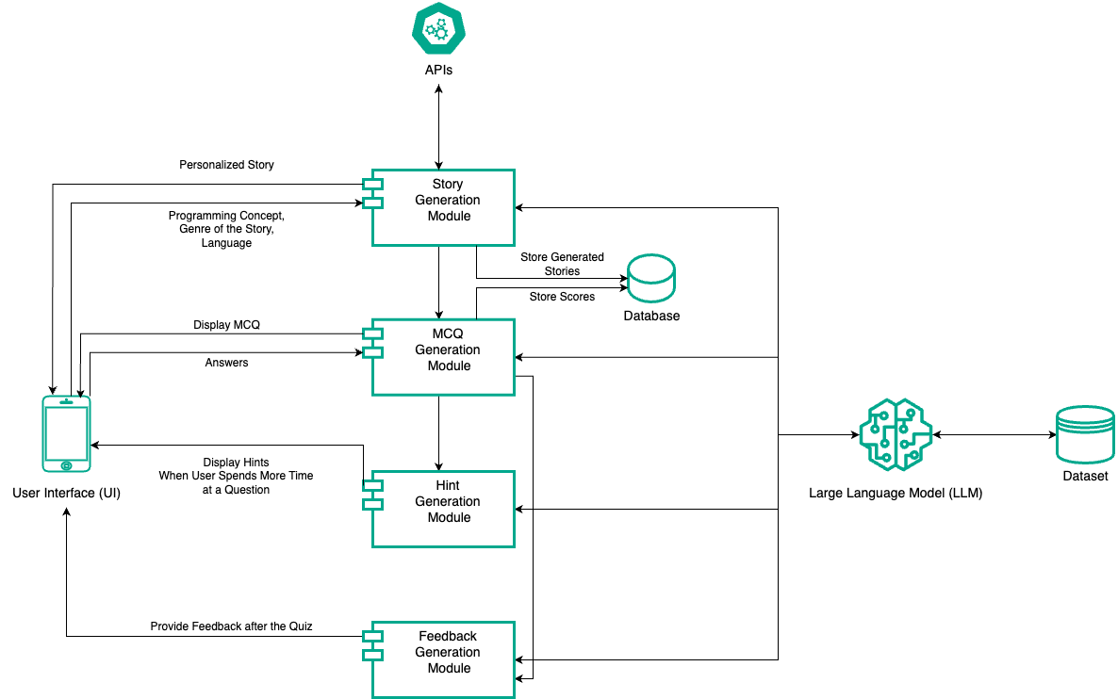
Methodology
System Diagram
IT21023446 | Sanjeevan M.C.M.A | R24-109

Slide 11
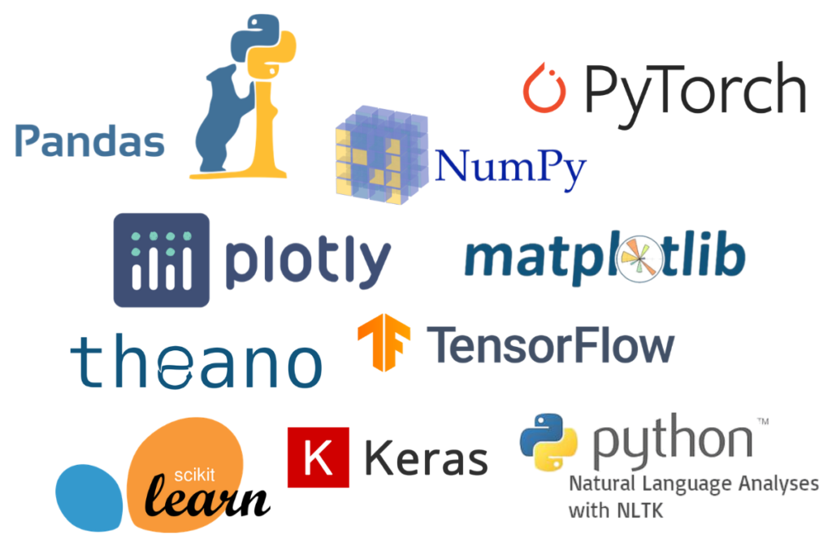
Methodology Cont’d
Technologies Used
Flutter
Python
LLM / GPT2
Libraries(Pandas, Torch, Transformers)
IT21023446 | Sanjeevan M.C.M.A | R24-109

Slide 12
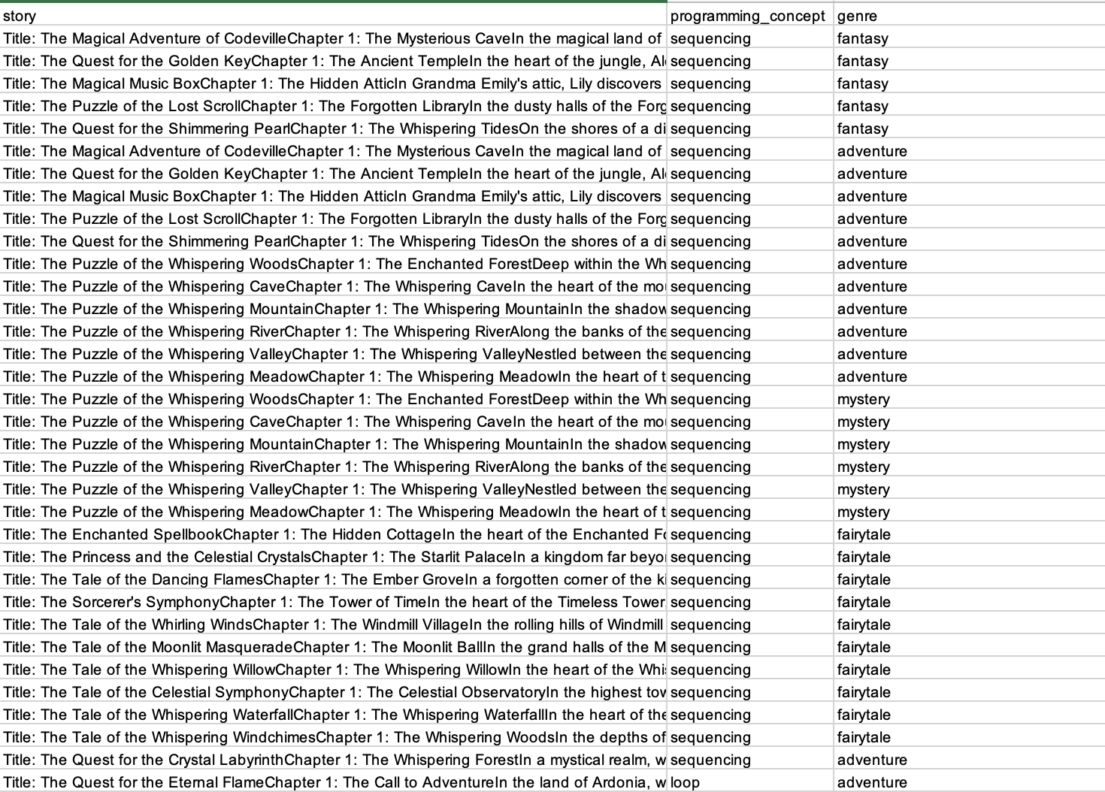
Methodology Cont’d
Model Dataset

Slide 13
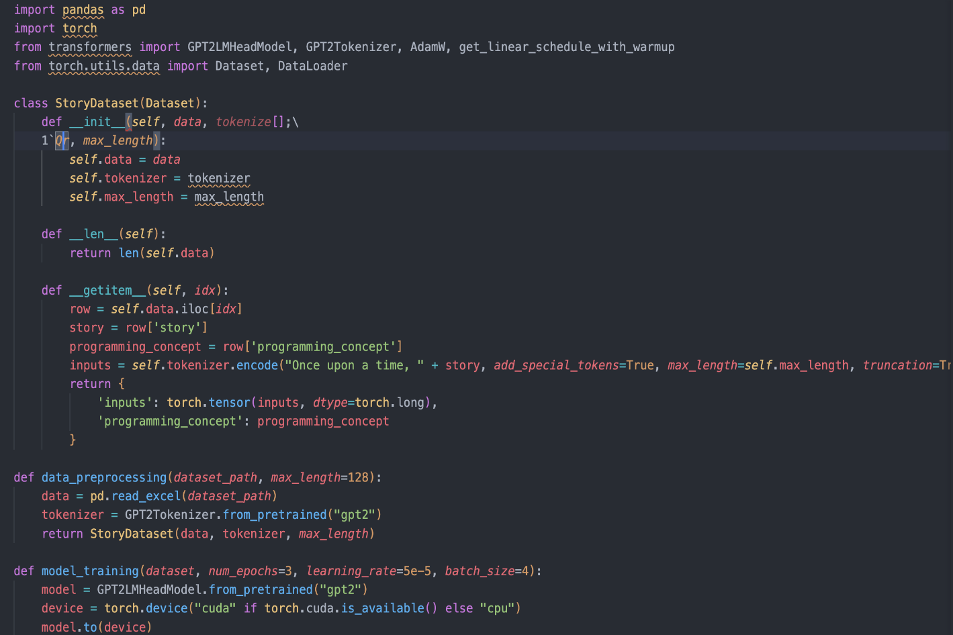
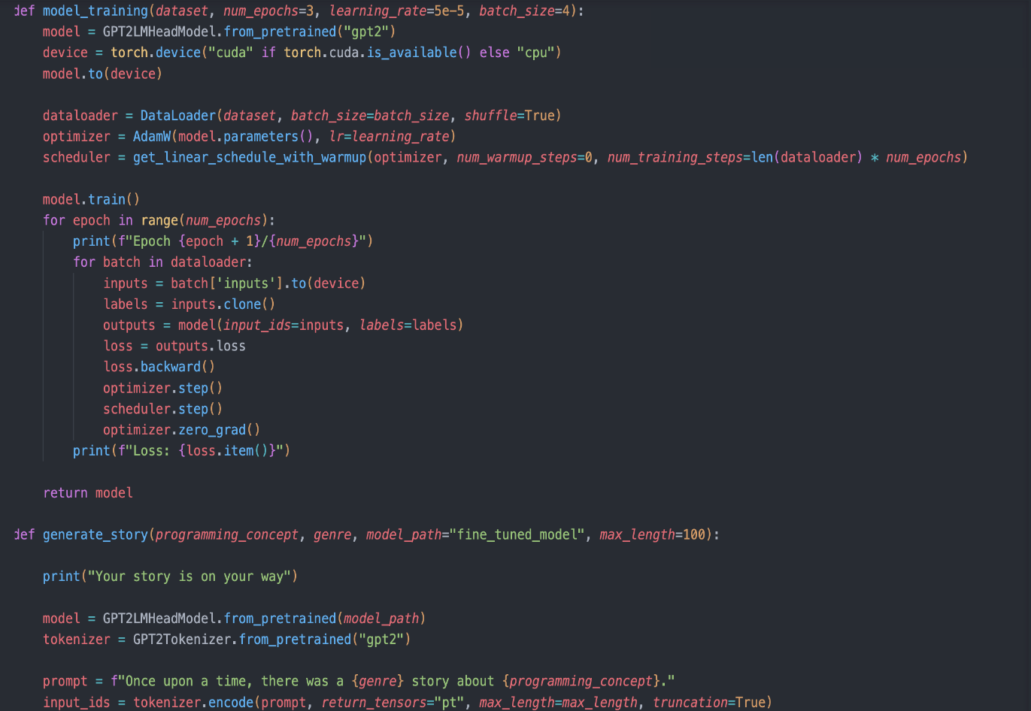
Methodology Cont’d
Model Code Snippets & Story Generation

Slide 14
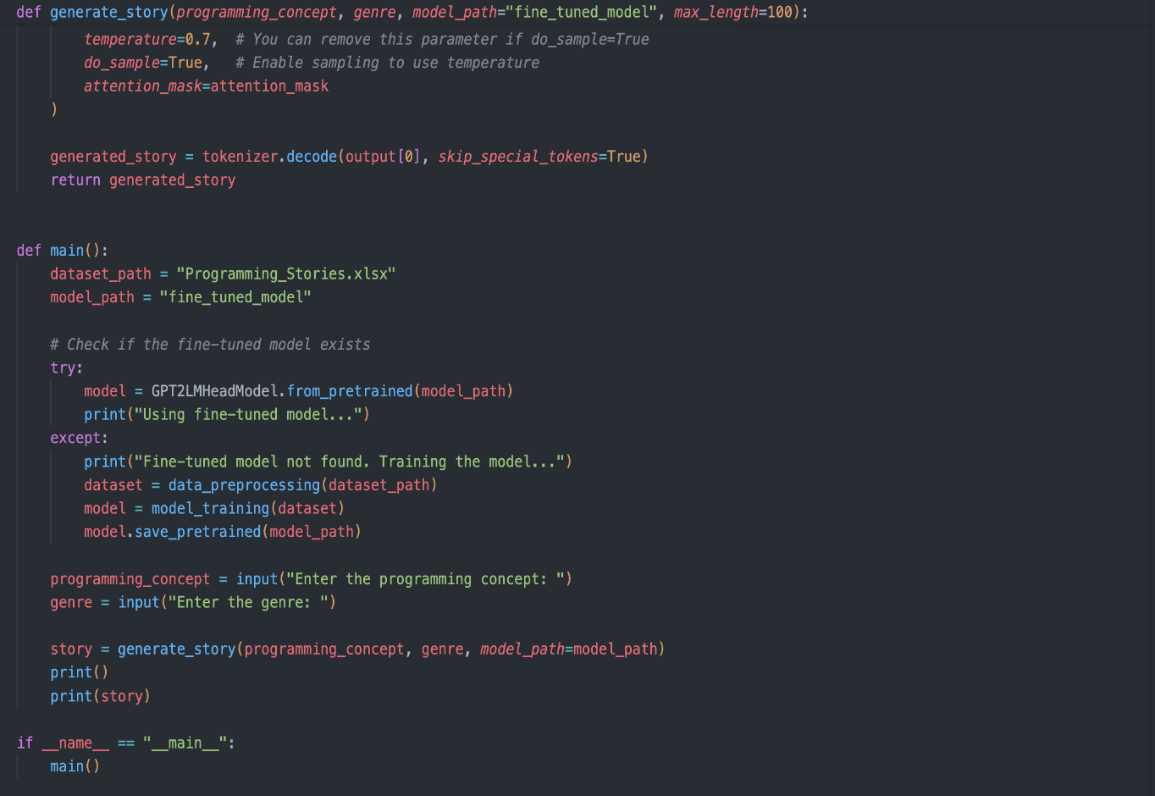
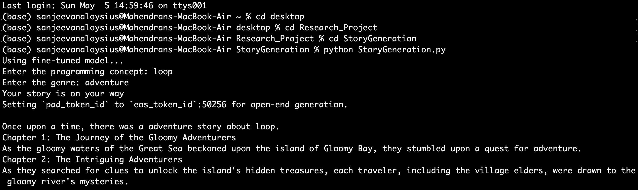
Methodology Cont’d

Slide 15
Methodology Cont’d
Challenges
Own Dataset
Generation Truncation

Slide 16
Methodology Cont’d
Future Plans
Complete the subcomponents
Prototype Design
Feedback Gathering
Research Paper
Complete 90%

Slide 17
Methodology Cont’d
System Requirements
Functional Requirements | Non Functional Requirements
User Registration and User Profile creation | Performance
Programming concepts Integration | Scalability
Story Customization | Acessability
Language Support | Security
Feedback Generation | Content Quality
Hint System | Reliability
IT21023446 | Sanjeevan M.C.M.A | R24-109

Slide 18
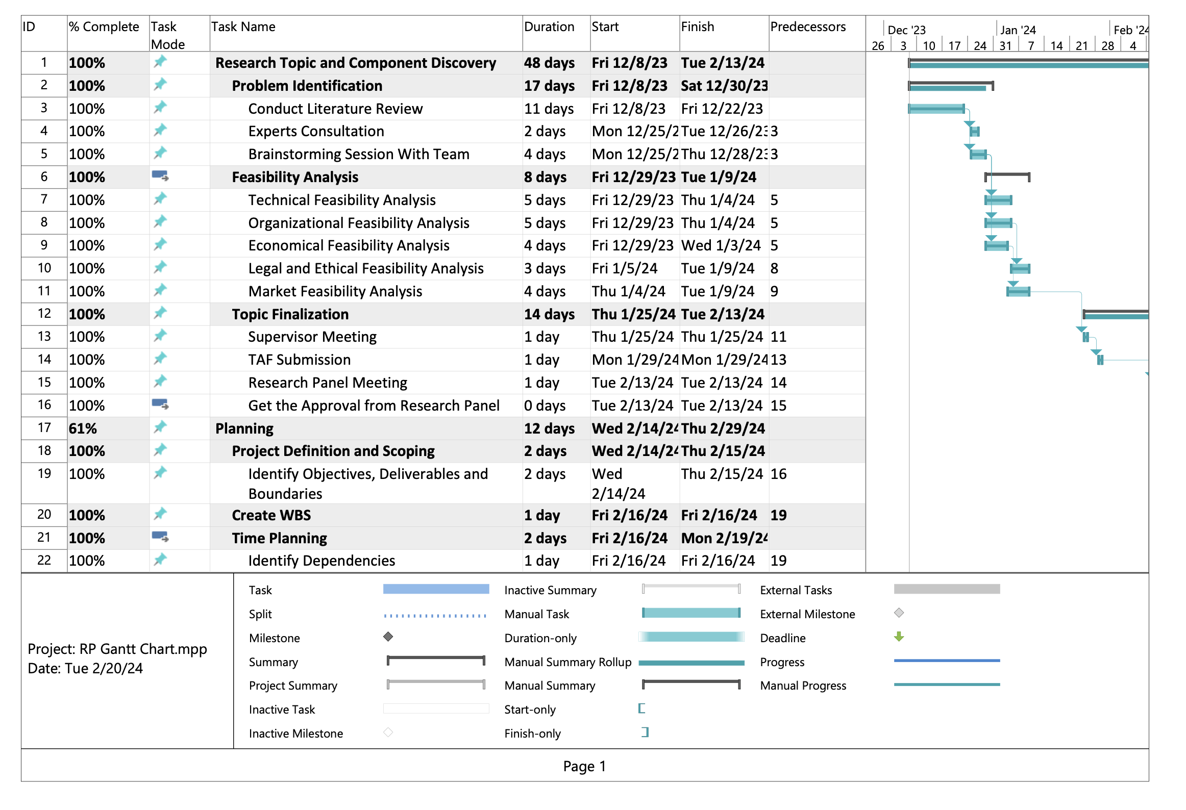
Methodology Cont’d
Gannt Chart
IT21023446 | Sanjeevan M.C.M.A | R24-109

Slide 19
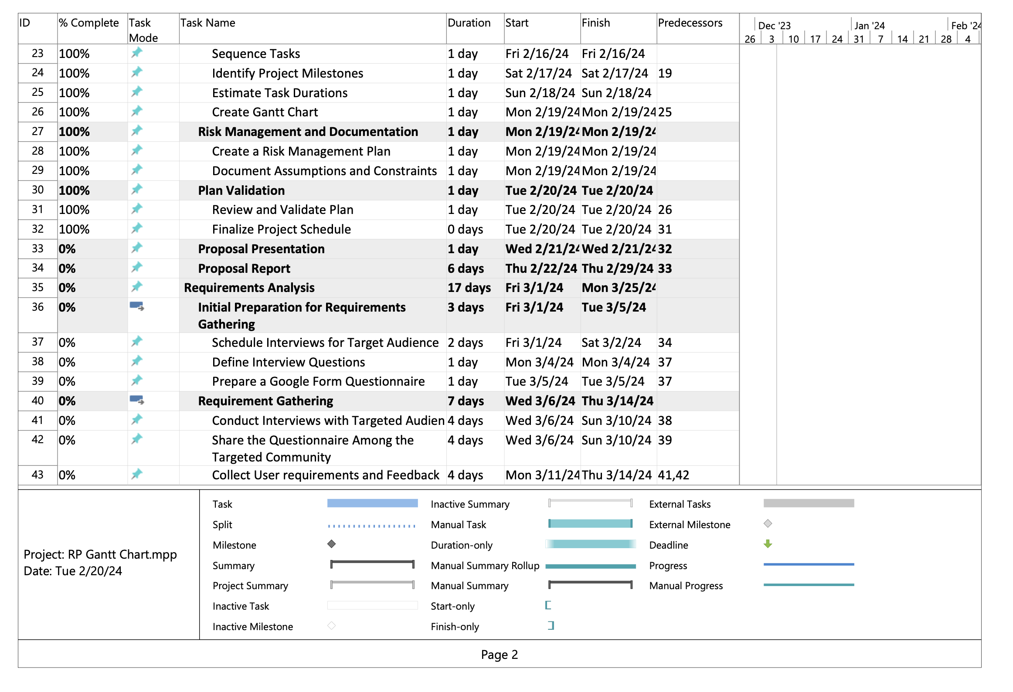
Methodology Cont’d
IT21023446 | Sanjeevan M.C.M.A | R24-109

Slide 20
Supporting Items
Budget
NO | Expenditure | Cost ($)
1 | Domain | 14.43$/M
2 | Hosting | 2.99$/M
3 | Traveling Expenses (4 Members ) | 12.84$/Trip
4 | Google Play Developer Fee | 25$ (One Time)
Total |  | 55.26$
IT21037306 | Fahmi M.F.A. | R24-109

Slide 21

Supporting Items
Commercialization
Offer a subscription-based model
Licensing and Partnerships
Share on social media add
Make it shareable
Provide an accurate description of our product
IT21023446 | Sanjeevan M.C.M.A | R24-109

Slide 22
References
[5] Simões Gomes, Tancicleide Carina, et al. “Exploring an Approach Based on Digital Games for Teaching Programming Concepts to Young Children.” International Journal of Child-Computer Interaction, vol. 16, June 2018, pp. 77–84, https://doi.org/10.1016/j.ijcci.2017.12.005.
[6] Dietz, G., Le, J. K., Tamer, N., Han, J., Gweon, H., Murnane, E. L., & Landay, J. A. (2021). StoryCoder: Teaching computational thinking concepts through storytelling in a voice-guided app for children. In Proceedings of the 2021 CHI Conference on Human Factors in Computing Systems (pp. 1-15). ACM. [doi:10.1145/3411764.3445039]
[7] Ruan, S., He, J., Rui, J., Burkle, J., Hakim, D., Wang, A., Yufeng, L., Zhou, L., Xu, Q., AbuHashem, A., Dietz, G., Murnane, E. L., Brunskill, E., & Landay, J. A. (2020). Children's math learning with feedback-augmented narrative technology. In Proceedings of the 2020 ACM Conference on Human-Computer Interaction (pp. 567-580). ACM. [doi:10.1145/3334423.3377805]
[8] Maloney, J., Resnick, M., Rusk, N., & Silverman, B. (2008). The design and evaluation of programming systems for children. In CHI '08 Proceedings of the SIGCHI Conference on Human Factors in Computing Systems (pp. 1025-1034). ACM
[9] Garcia, P., Glassman, E., [et al.] (2022). "An Empirical Study of Mobile Programming Environments for Young Children," IEEE Transactions on Learning Technologies, 14(3), pp. 456-469.
IT21023446 | Sanjeevan M.C.M.A | R24-109

Slide 23
References Cont’d
[10] M. Videnovik, A. M. Bogdanova, and V. Trajkovik, "Game-based learning approach in computer science in primary education: A systematic review, vol. 1, no. 100616, Jan. 2023. [Online]. Available: https://doi.org/10.1016/j.entcom.2023.100616
[11] "Improving Teaching and Learning Computer Programming in Schools through Educational Software." Olympiads in Informatics, vol. 11, pp. 55-75, 2017, doi:10.15388/ioi.2017.05
[12] Devananda Sreekanth and Dr. Nasrin Dehbozorgi Title: "AI-based Quiz Generation: The Role of LLMs in Digital Education" Conference: C-DAY FALL 2023 Year: 2023 DOI
[13] Abraham Karikari, Emmanuel Opoku Kumi, Ellen Afia Achiaa, and Juliet Adu, "The Impact of Using Mother Tongue as Instructional Language in Teaching and Learning of Mathematics in Rural Primary Schools: A Case Study of four selected Schools in Sefwi Akontombra District, Ghana," International Journal of Novel Research in Education and Learning, vol. 9, issue 1, pp. 26-38, January-February 2022
[14] Smith, J., & Johnson, A. (2023). "Generating Multiple Choice Questions for Computing Courses Using Large Language Models." IEEE Transactions on Education, 10(5), 123-135. DOI: 10.1109/TE.2023.456789.
[15] Z. Zhao et al., "More human than human: LLM-generated narratives outperform human-LLM interleaved narratives," in Proceedings of the 15th Conference on Creativity and Cognition (C&C '23), June 2023, pp. 368-370, doi: 10.1145/3591196.3596612.
IT21023446 | Sanjeevan M.C.M.A | R24-109

Slide 24

Customized Kids Assisting system IT21037306 | Fahmi M.F.A.
Software Engineering Specialization
IT21037306 | Fahmi M.F.A. | R24-109

Slide 25
Research Questions ?
How to assist kids when they are getting doubts ?
How to get input from kids ?
How to provide the suitable answer for their doubts ?
How to identify the kids questions even those are not properly structed?
What are the ways to provide the answers?
IT21037306 | Fahmi M.F.A. | R24-109

Slide 26
Research Gap
Research Papers | Methodology | Technology | Gap | My Component
Software Agent in E-Learning Mobile Application for Kindergarten Students [16]. | Questionnaire Testing Semi-Structured Interviews Feedback Collection Observational Study | Not Mentioned But They Developed Android App | Not providing a assistance to kids through the app | Providing a proper assistance system through the app.
Learning Math through Mobile Game for Primary School Students [17]. | Designing the Model of Learning Creating User Interface Prototypes | Not Mentioned | Helping kids through communicate via forum. Hard to maintain safety & privacy. Requires lots of human interaction. | Providing a proper assistance system through the app.
Digital Learning For Kids [18]. | Extract the information Sentiment analysis from the text and audio input. | Text to Speech (TTS) Machine Learning Natural Language Processing Web Scraping: | Not providing a assistance to kids through the app | Providing a proper assistance system through the app.
LITTLE PROFESSOR: A MOBILE LEARNING GAME FOR KIDS [19] | Used ADDIE Model(Analysis, Design, Development, Implementation, and Evaluation) | Android App Used GBL (Game-Based Learning) principles | Not providing a assistance to kids through the app | Providing a proper assistance system through the app.
IT21037306 | Fahmi M.F.A. | R24-109

Slide 27
Specific and Sub Objectives
Develop a customized kids' assistance system to provide real-time support for learning challenges by implementing a structured breakdown of identified problems and promote their critical thinking.
Design a interactive and user-friendly interface for kids.
Get the input from kids (Voice / Image) and Transfer it to Text Format.
Translate the text to English if it’s from another language.
Design a flexible and expandable KBA
KBA (Knowledge Based Agent)
Provide a compact problem breakdown structure to kids.
IT21037306 | Fahmi M.F.A. | R24-109

Slide 28
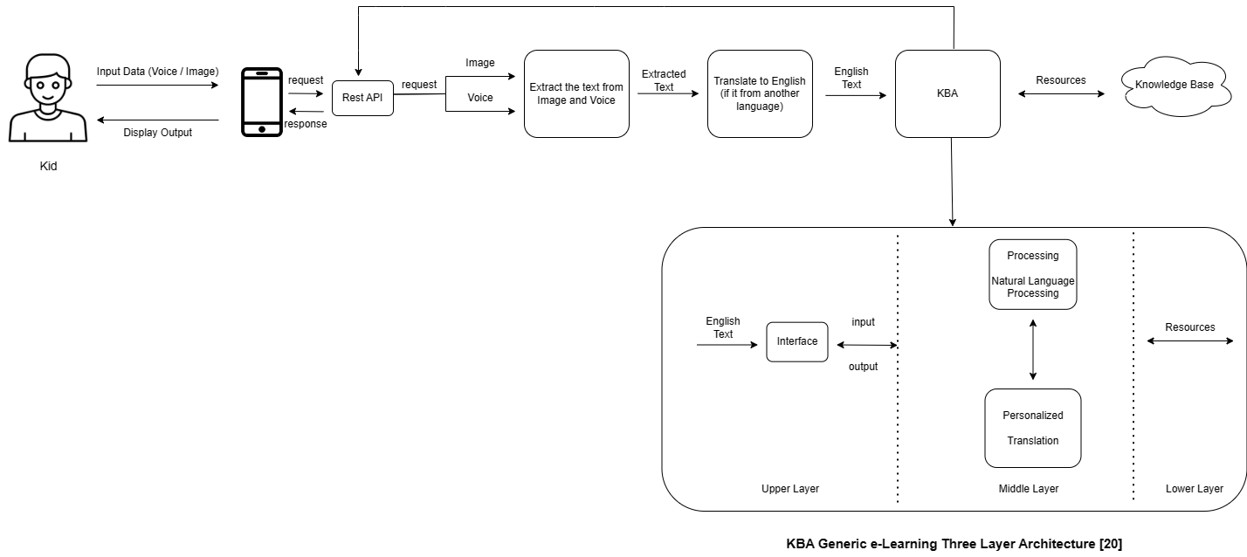
Methodology
System Diagram
IT21037306 | Fahmi M.F.A. | R24-109

Slide 29
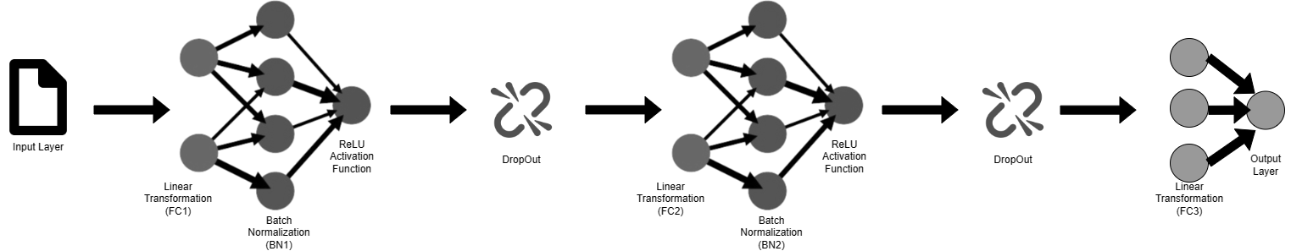
Architecture Diagram
NLP QA Model
IT21037306 | Fahmi M.F.A. | R24-109

Slide 30
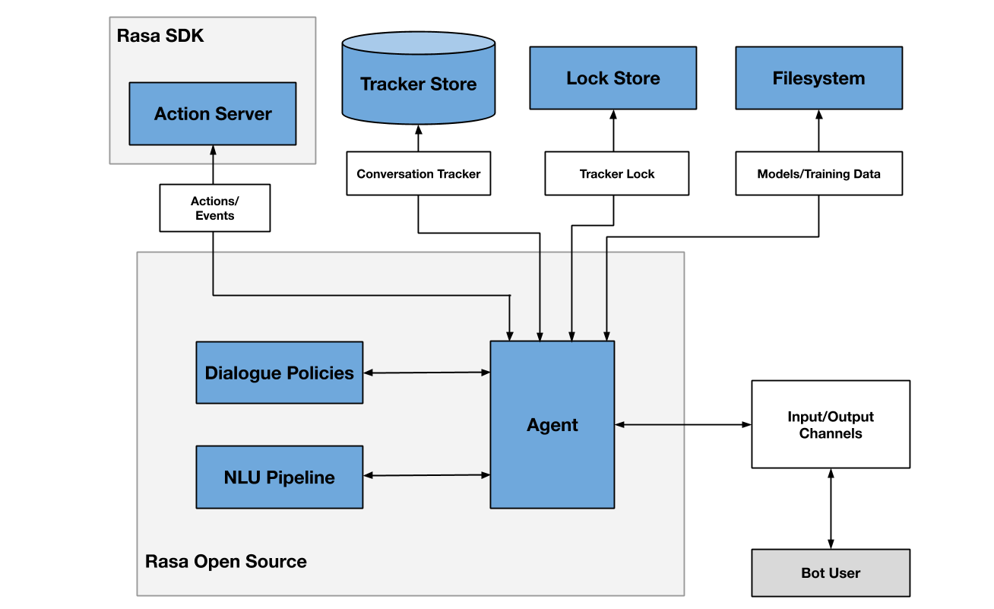
Architecture Diagram
RASA Model
IT21037306 | Fahmi M.F.A. | R24-109

Slide 31
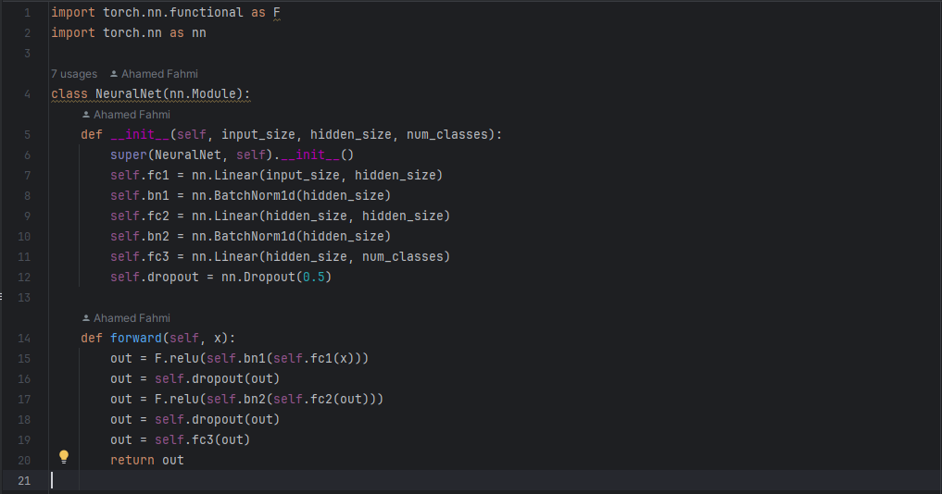
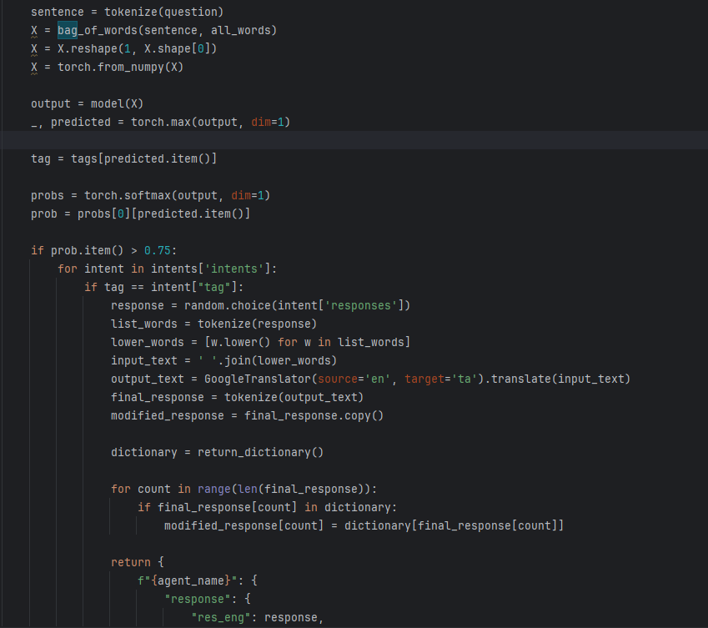
Methodology Cont’d
Code snippet (NLP QA Model)
IT21037306 | Fahmi M.F.A. | R24-109

Slide 32
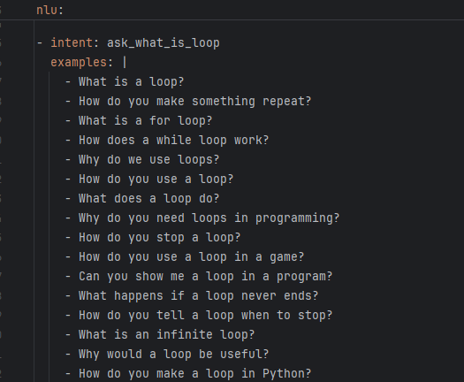
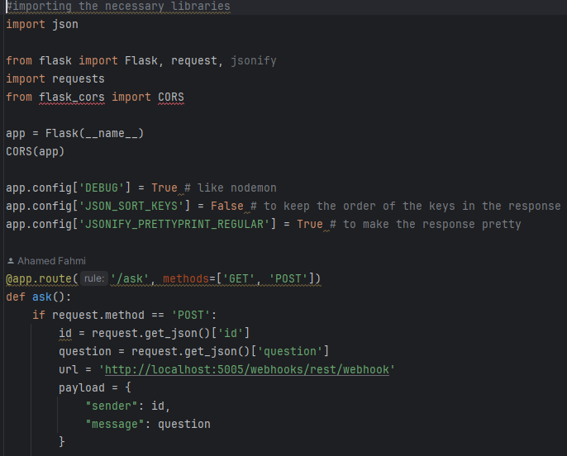
Methodology Cont’d
Code snippet (RASA Model)
IT21037306 | Fahmi M.F.A. | R24-109

Slide 33
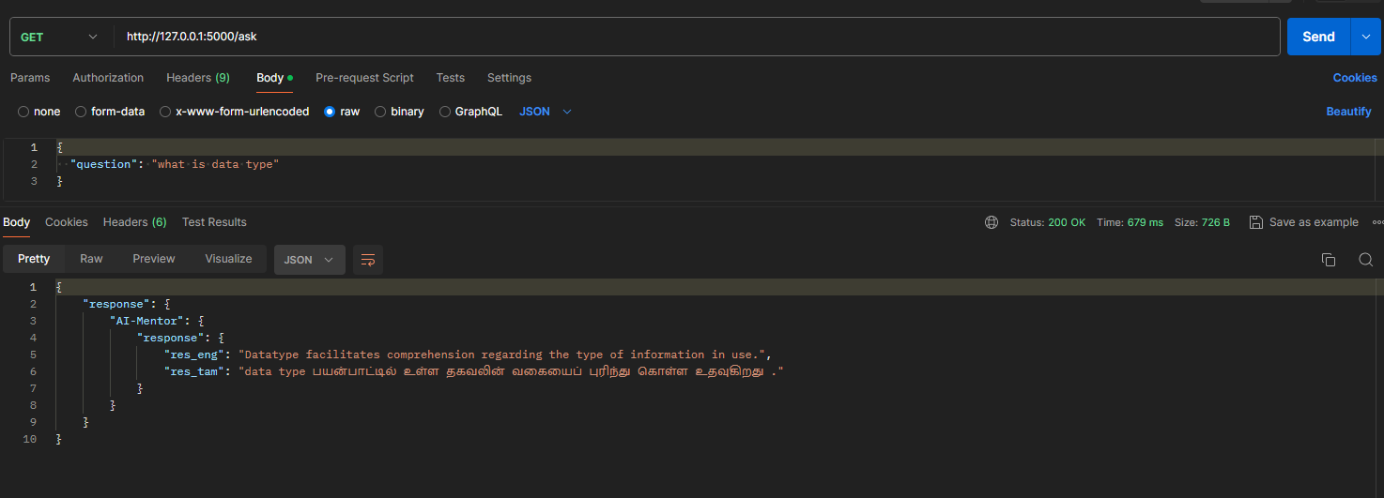
Methodology Cont’d
Output (NLP QA Model)
IT21037306 | Fahmi M.F.A. | R24-109

Slide 34
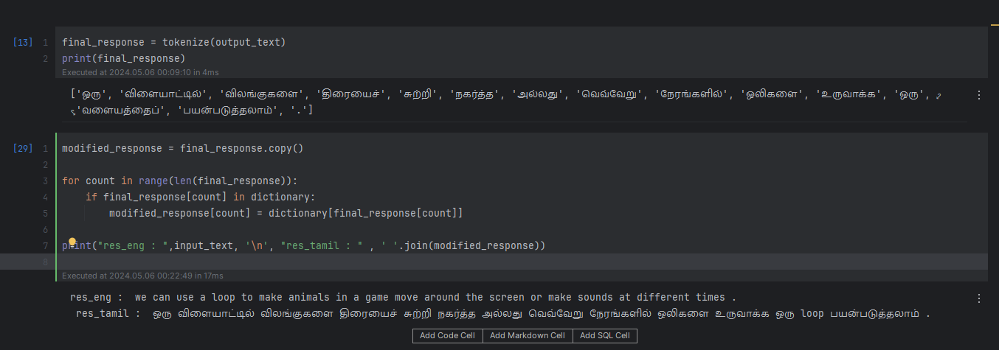
Methodology Cont’d
Output (RASA Model)
IT21037306 | Fahmi M.F.A. | R24-109

Slide 35
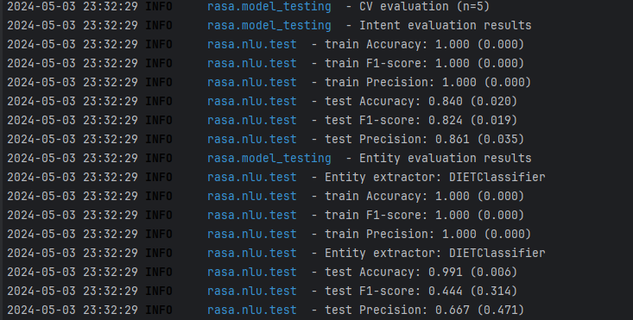
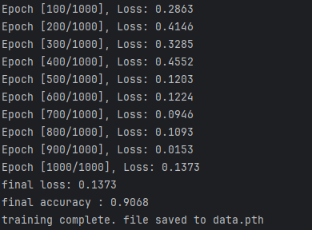
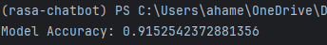
Models
RASA
Accuracy
Testing accuracy
CV-Evaluation : 0.840
Entity Evaluation : 0.991
Training accuracy of around 1.000
NLP QA Model
Accuracy
\
Testing Accuracy = 0.9152
Training Accuracy = 0.9068
IT21037306 | Fahmi M.F.A. | R24-109

Slide 36
Challenges
Initially, I chose Reinforcement Learning technology; however, after a period, I understood that it was not suitable for my function, so I chose NLP.
I had issue in English to Tamil Translation, I have tried these models
Hemanth-thunder/english-tamil-mt
Mr-Vicky-01/English-Tamil-Translator
Mr-Vicky-01/Fine_tune_english_to_tamil
suriya7/English-to-Tamil
So that , I have chosen another translation library called deep translation to translation.
The selected school frequently observed extended term breaks, posing a logistical challenge for the research endeavor.
After the vacation, I hadn't had the chance to meet with them because they were focused on completing their syllabus.
Hard to balance workload between academic activities and research project.
IT21037306 | Fahmi M.F.A. | R24-109

Slide 37
Upcoming Plan
Visit the school and get proper data from students and create a proper data set.
Find the which kind of breakdown structure is suitable for kids. And Implement that part.
Create a UI design for the app, with proper guidelines and based on the recommendations provided by Latiff et al. in their paper on user interface design for children's mobile learning applications [21].
Create a figma prototype and give it to the kids and get the feedback from them and modify the solution according to that.
Start to write the research paper.
Finally complete the overall product.

Slide 38
Methodology Cont’d
Technologies Used
Flutter
Python
RASA
Libraries (NLTK, Deep Translator, Flask, PyTorch, Numpy, scikit-learn)
IT21037306 | Fahmi M.F.A. | R24-109

Slide 39
Methodology Cont’d
System Requirements
Functional Requirements | Non Functional Requirements
User should be able to input data as image or voice | Performance
User should be able to see breakdown structure of problem | Reliabilty
User should be able to use English or Tamil language to input data
User should be able to see the output in Tamil language
IT21037306 | Fahmi M.F.A. | R24-109

Slide 40
Methodology Cont’d
Personal Requirements
Learning and time commitment
Adaptability and flexibility
Respectful and supportive team dynamics
Effective team communication
Collaborative Problem-Solving
IT21037306 | Fahmi M.F.A. | R24-109

Slide 41
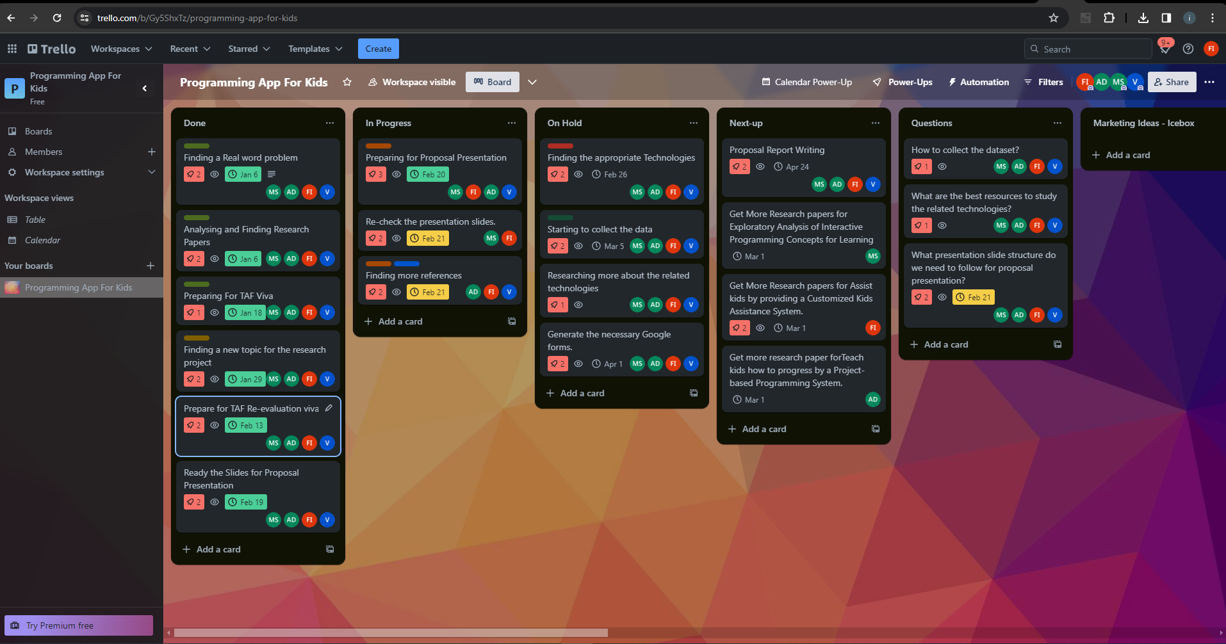
Methodology Cont’d
IT21037306 | Fahmi M.F.A. | R24-109

Slide 42
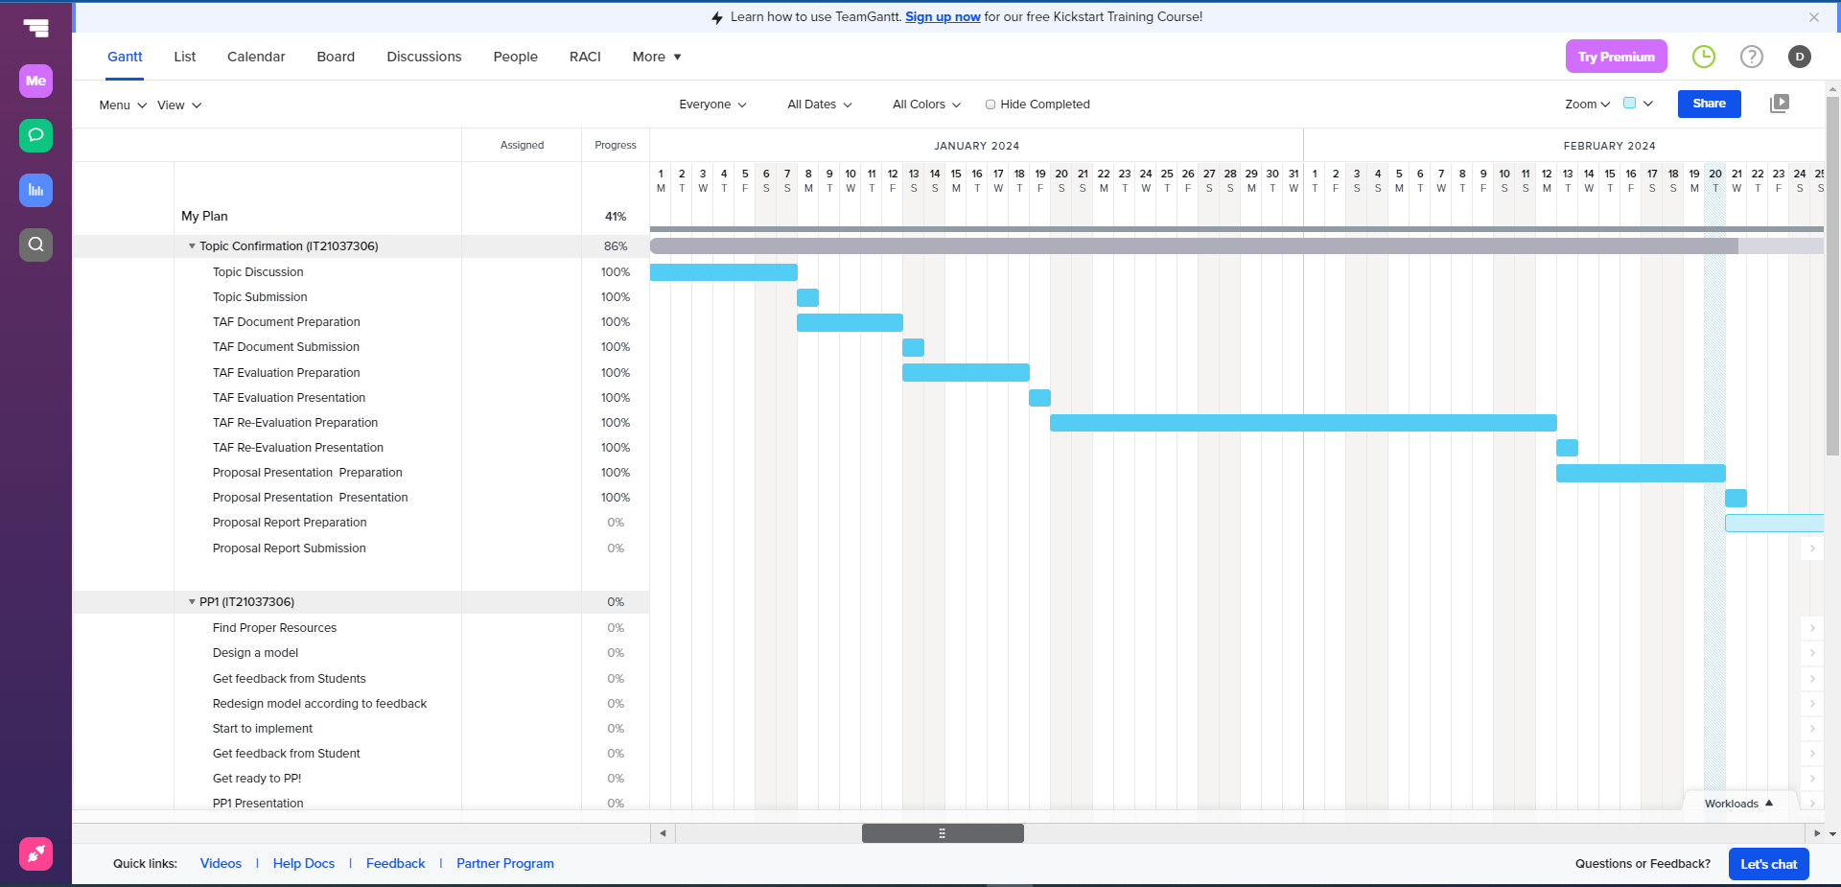
Methodology Cont’d
Gantt Chart
IT21037306 | Fahmi M.F.A. | R24-109

Slide 43
Supporting Items
Budget
NO | Expenditure | Cost ($)
1 | Domain | 14.43$/M
2 | Hosting | 2.99$/M
3 | Traveling Expenses (4 Members ) | 12.84$/Trip
4 | Google Play Developer Fee | 25$ (One Time)
Total |  | 55.26$
IT21037306 | Fahmi M.F.A. | R24-109

Slide 44
Supporting Items
Commercialization
Offer a subscription-based model
Licensing and Partnerships
Share on social media add
Make it shareable
Provide an accurate description of our product
IT21037306 | Fahmi M.F.A. | R24-109

Slide 45
References
[16] Researchgate.net. [Online]. Available: https://www.researchgate.net/profile/Azzam_Sleit/publication/344540445_2017_-_DISCRETE_TIME_EVENTS_REPRESENTATION_using_mapreduce/links/5f7edc50458515b7cf6f5902/2017-DISCRETE-TIME-EVENTS-REPRESENTATION-using-mapreduce.pdf#page=25. [Accessed: 20-Feb-2024].
[17] Researchgate.net. [Online]. Available: https://www.researchgate.net/profile/Harco-Leslie-Hendric-Spits-Warnars/publication/343305550_Learning_Math_through_Mobile_Game_for_Primary_School_Students/links/5facc43ba6fdcc9389ab3858/Learning-Math-through-Mobile-Game-for-Primary-School-Students.pdf. [Accessed: 20-Feb-2024].
[18] Researchgate.net. [Online]. Available: https://www.researchgate.net/profile/Kithusshand-Raveendran/publication/377209836_International_Journal_of_Advanced_Research_and_Publications_Digital_Learning_For_Kids/links/659a59523c472d2e8eb9827e/International-Journal-of-Advanced-Research-and-Publications-Digital-Learning-For-Kids.pdf. [Accessed: 20-Feb-2024].
[19] Hussain, Azham & Najahah, Abdul. (2013). LITTLE PROFESSOR: A MOBILE LEARNING GAME FOR KIDS.
[20] K. Sakthiyavathi and K. Palanivel, “A generic architecture for agent based E-learning system,” in 2009 International Conference on Intelligent Agent & Multi-Agent Systems, 2009, pp. 1–5.
[21] H. S. A. Latiff, R. Razali, and F. F. Ismail, “User interface design Guidelines for Children Mobile learning Applications,” International Journal of Recent Technology and Engineering, vol. 8, no. 3, pp. 3311–3319, Sep. 2019, doi: 10.35940/ijrte.c5434.098319.
IT21037306 | Fahmi M.F.A. | R24-109

Slide 46

Level-based IT Fundamental Knowledge Evaluation IT20275006 | Lakpriya K.H.A.V
Software Engineering Specialization
IT20275006 | Lakpriya K.H.A.V | R24-109

Slide 47

Introduction Background
Digital Era Education: Technology integration is essential for modern education.
Challenges in IT Education: Assessing and reinforcing IT basics in young learners is difficult.
Solution with Machine Learning: Traditional methods lack personalization; this component uses machine learning for a personalized evaluation system.
IT20275006 | Lakpriya K.H.A.V | R24-109

Slide 48

Research Questions
Testing Tech Understanding in Kids:
Even though kids use technology a lot, it's hard to know if they really get it.
Normal tests don't really understand what each kid needs to learn.
The tests we have now might not cover everything kids should know about tech.
Why It's Important for Kids to Understand Tech:
If kids don't understand basic tech stuff now, they might have problems later in school or when they grow up.
They might have trouble using technology in their everyday life.
This could make it tough for them to find good jobs and do cool stuff with technology.
Making Better Tests for Kids:
We want to make tests that really help kids learn tech stuff better.
Our idea is to make tests that change based on what each kid needs to learn.
This will help kids learn better and do well in school and later in life.
IT20275006 | Lakpriya K.H.A.V | R24-109

Slide 49

Specific and Sub Objectives
Developing a personalized evaluation system using machine learning to reinforce young learners' IT knowledge for deeper understanding and mastery.
Establish a structured assessment framework with increasing difficulty levels.
Develop Machine Learning Models
Establish Data Collection and Analysis System
IT20275006 | Lakpriya K.H.A.V | R24-109

Slide 50







Methodology
Technologies
IT20275006 | Lakpriya K.H.A.V | R24-109

Slide 51
Methodology
Requirements
Functional Requirements | Non-Functional Requirements
Leveled Assessment System | Usability and Accessibility
Question Delivery and Evaluation | Performance and Scalability
Performance Tracking and Analytics | Security and Data Privacy
Machine Learning Models | Cross-platform Compatibility
IT20275006 | Lakpriya K.H.A.V | R24-109

Slide 52
Methodology
Requirements
Software Requirements | User Requirements
Machine Learning Libraries: scikit-learn, TensorFlow | Easy-to-use interface for students to navigate through levels and questions.
Data Processing Libraries: Pandas, NumPy | Immediate feedback on answer correctness and overall performance.
Database Management System: MongoDB | Ability to track progress, view completed levels, and retry questions.
Development Stack: Flutter, Python, Node.js | Secure and private handling of personal information and performance data.
IT20275006 | Lakpriya K.H.A.V | R24-109

Slide 53
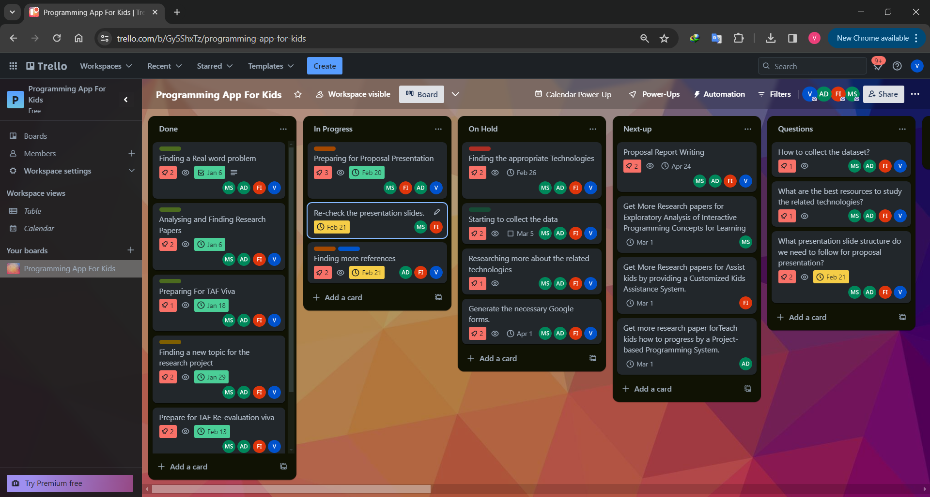
Methodology
IT20275006 | Lakpriya K.H.A.V | R24-109

Slide 54
Current Progress
Predicting Passing Marks: Regression model to estimate the likelihood of a student achieving a passing score based on various factors.
Decision on Level Skipping: Classification model to determine whether a student should skip a level or proceed to the next level based on their performance.
Evaluating IT Knowledge: Regression model to assess a student's overall comprehension of IT fundamentals.
Customized Question Recommendation: Recommendation system to suggest personalized questions or learning resources based on a student's strengths, weaknesses, and learning patterns.
IT20275006 | Lakpriya K.H.A.V | R24-109

Slide 55
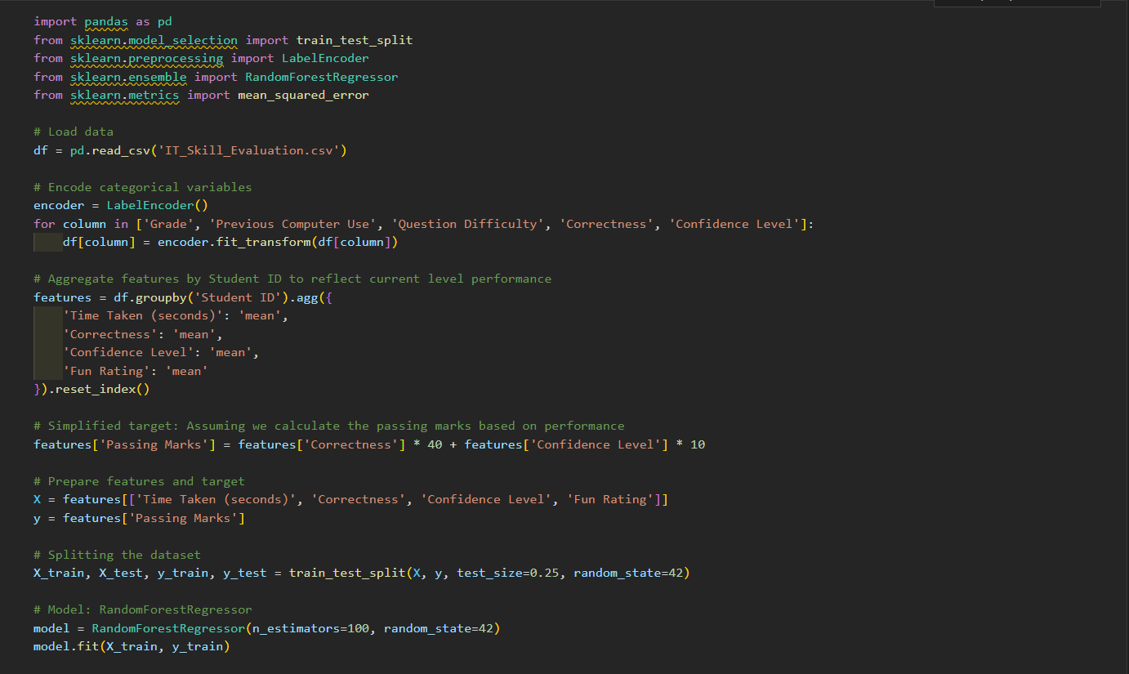
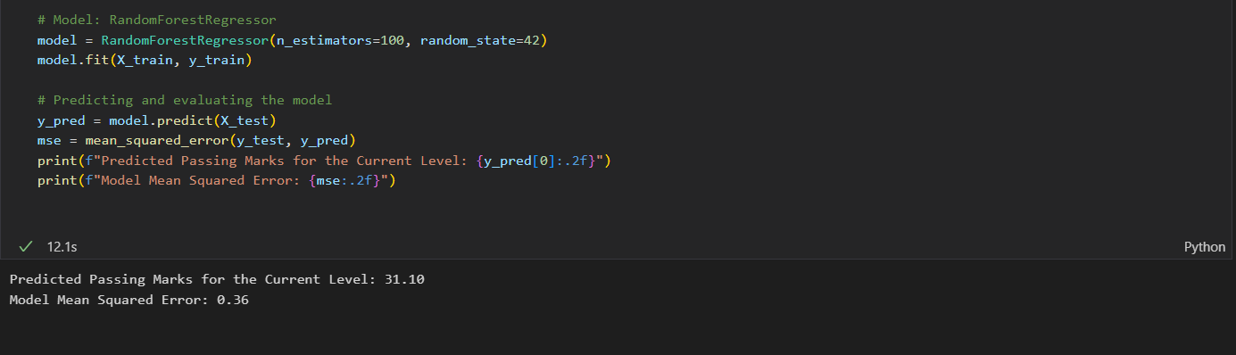
Project Evidence
Predicting Passing Marks - Regression model
IT20275006 | Lakpriya K.H.A.V | R24-109

Slide 56
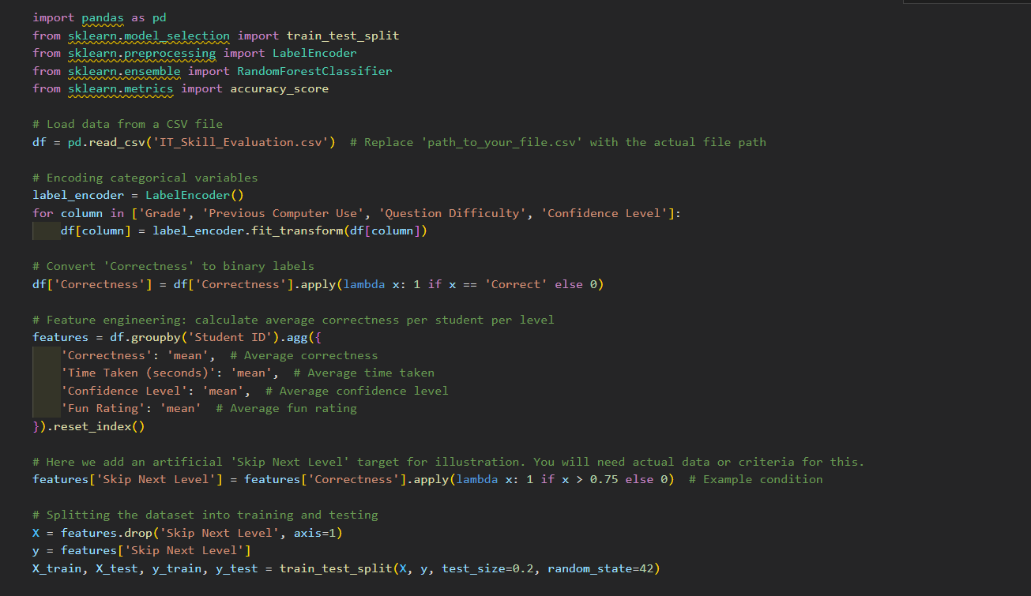
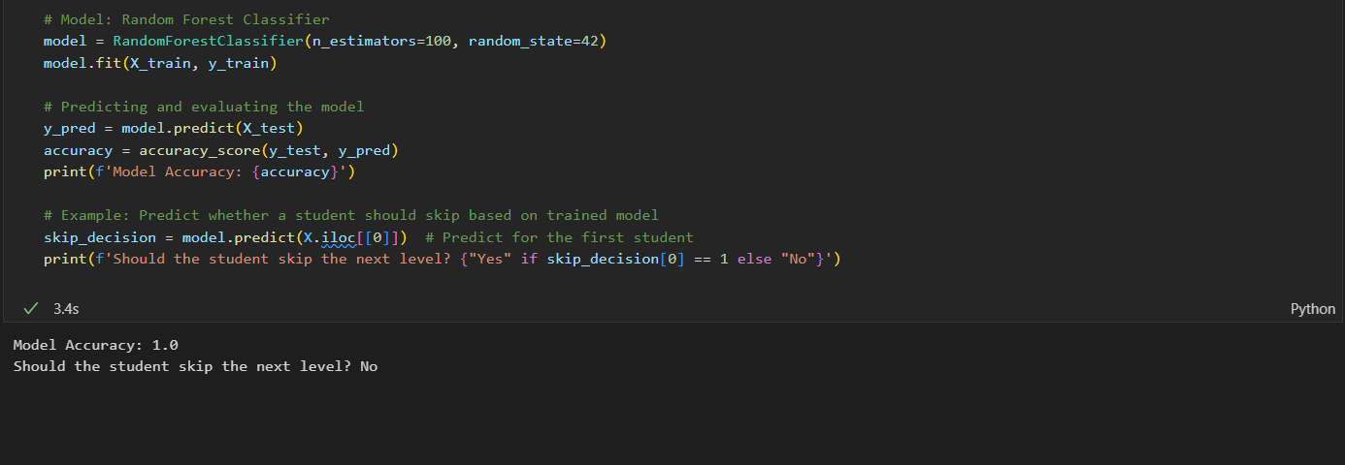
Project Evidence
Decision on Level Skipping - Classification model
IT20275006 | Lakpriya K.H.A.V | R24-109

Slide 57
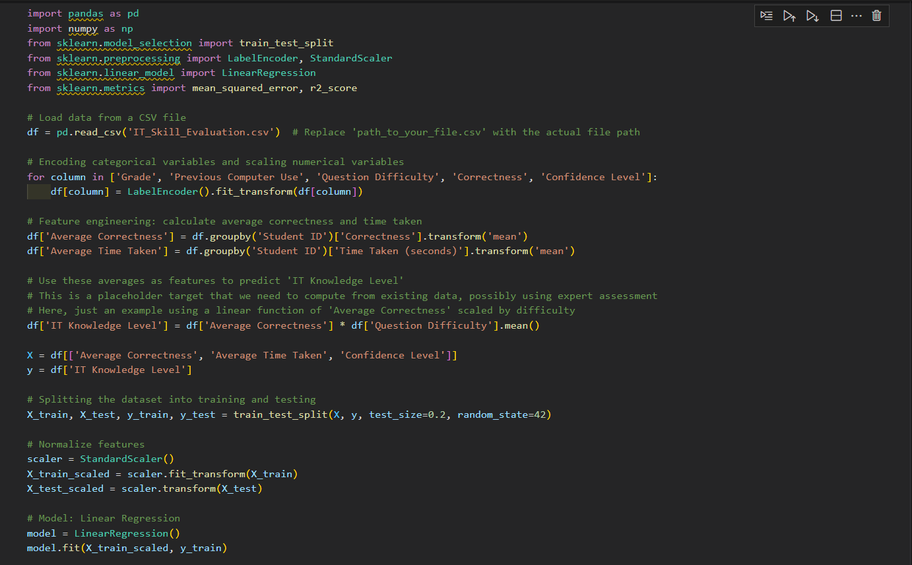
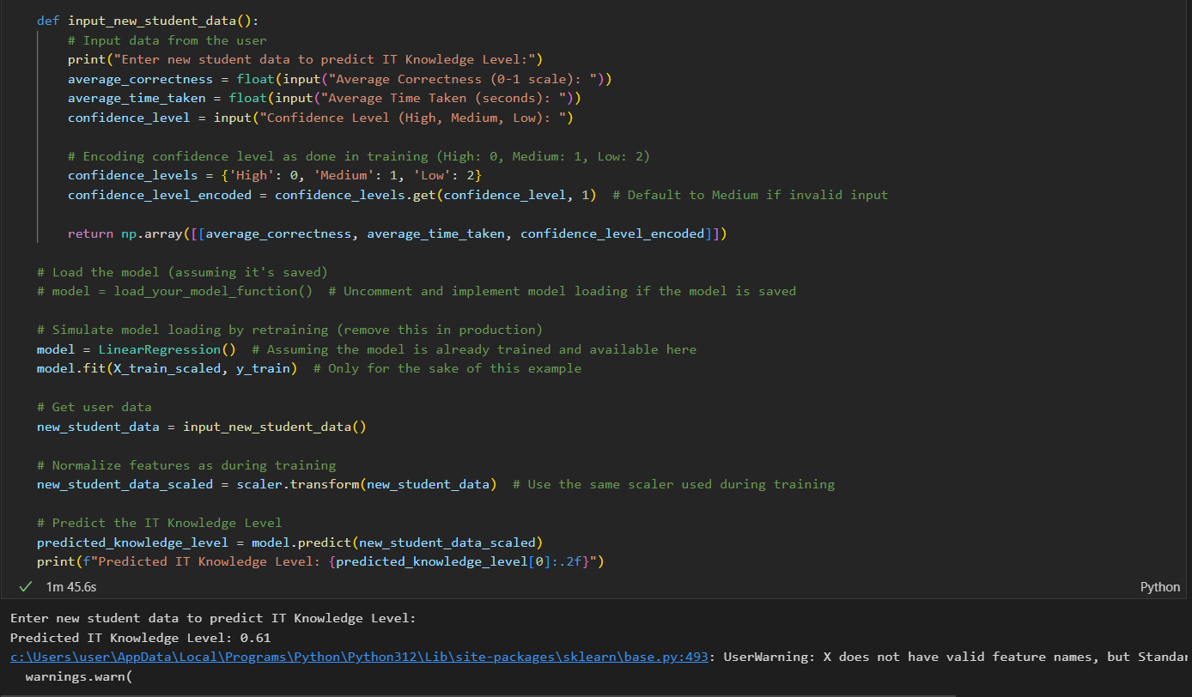
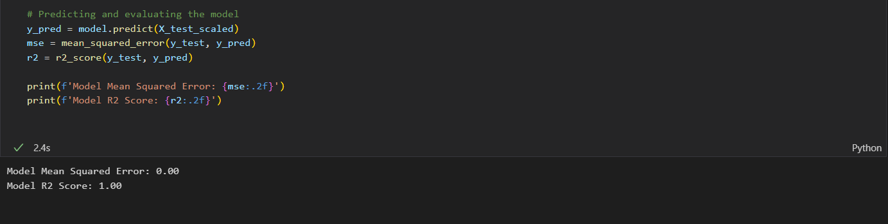
Project Evidence
Evaluating IT Knowledge - Regression model
IT20275006 | Lakpriya K.H.A.V | R24-109

Slide 58
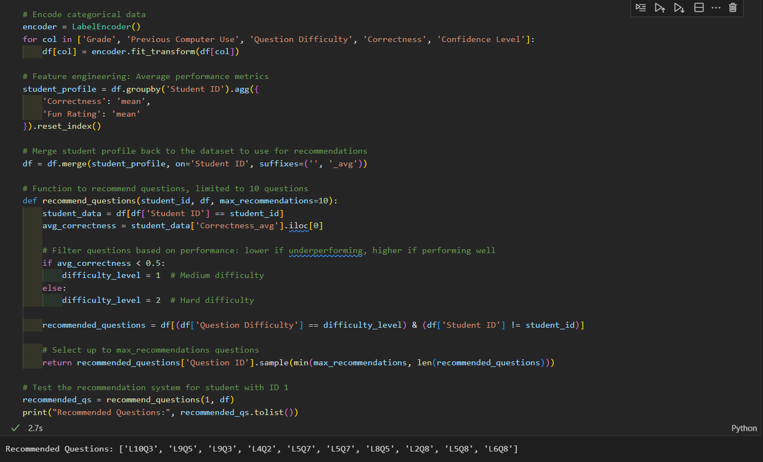
Project Evidence
Customize questions Recommendation system
IT20275006 | Lakpriya K.H.A.V | R24-109

Slide 59

Next Expected Progress
Develop a user-friendly mobile application using Flutter framework
Integrate the machine learning models into the mobile app
Design an intuitive and engaging user interface for young learners
Implement gamification elements and progress tracking
Conduct user testing and gather feedback for iterative improvements
IT20275006 | Lakpriya K.H.A.V | R24-109

Slide 60
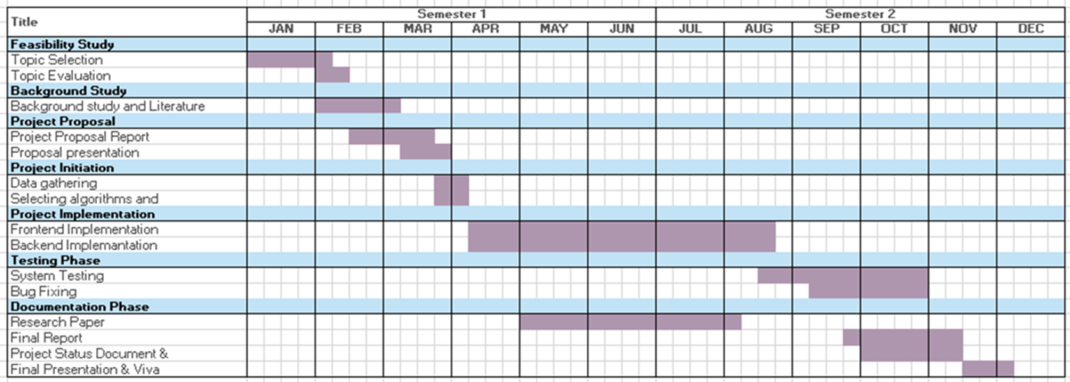
Gantt Chart
IT20275006 | Lakpriya K.H.A.V | R24-109

Slide 61
Supporting Items
Budget
NO | Expenditure | Cost ($)
1 | Domain | 14.43$/M
2 | Hosting | 2.99$/M
3 | Traveling Expenses (4 Members ) | 12.84$/Trip
4 | Google Play Developer Fee | 25$ (One Time)
Total |  | 55.26$
IT20275006 | Lakpriya K.H.A.V | R24-109

Slide 62
Supporting Items
Commercialization
Offer a subscription-based model
Licensing and Partnerships
Share on social media add
Make it shareable
Provide an accurate description of our product
IT20275006 | Lakpriya K.H.A.V | R24-109

Slide 63
References
[22] Redecker, C., & Johannessen, Ø. (2013). Changing assessment – Towards a new assessment paradigm using ICT. European Journal of Education, 48(1), 79-96.
[23] Tomlinson, C. A. (2014). The differentiated classroom: Responding to the needs of all learners. ASCD.
[24] Leutner, D. (2004). Adaptive multimedia learning systems. Journal of Educational Multimedia and Hypermedia, 13(4), 365-384.
[25] Polyzou, A., & Karypis, G. (2016). Grade prediction with models specific to students and steps. International Educational Data Mining Society.
[26] Huang, S., & Fang, N. (2013). Predicting student academic performance in an engineering dynamics course: A comparison of four types of predictive mathematical models. Computers & Education, 61, 133-145.
[27] Bull, J., & McKenna, C. (2004). Blueprint for computer-assisted assessment. Routledge.
[28] Nicol, D. J., & Macfarlane-Dick, D. (2006). Formative assessment and self-regulated learning: A model and seven principles of good feedback practice. Studies in Higher Education, 31(2), 199-218.
[29] Sadler, D. R. (1989). Formative assessment and the design of instructional systems. Instructional Science, 18(2), 119-144.
IT20275006 | Lakpriya K.H.A.V | R24-109

Slide 64
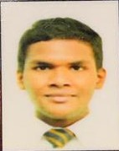
IT21084522 | DISSANAYAKE A. L.
Software Engineering Specialization
IT21084522 | Dissanayake A. L. | R24-109

Slide 65
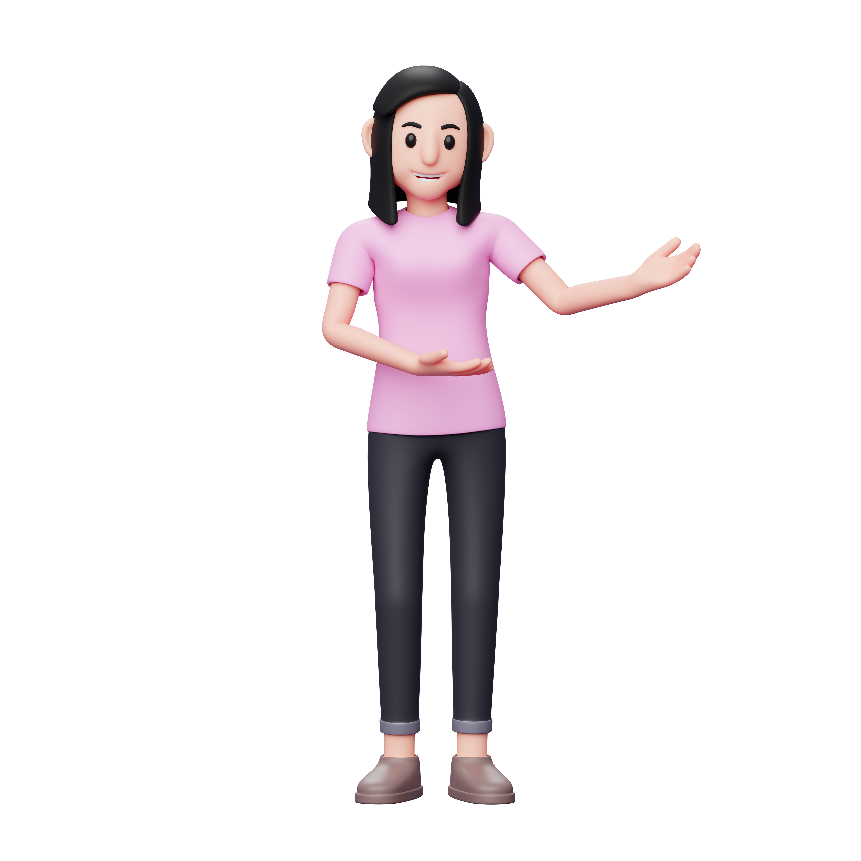
Introduction
This study delves into the transformative impact of a Project and Quizes Based Programming Learning App on school students in grades 6 to 8. The research focuses on key elements such as skill development, practical application, real-time language translation for peer feedback, and group problem-solving. Additionally, it explores the machine learning model's efficacy in tailoring individual and group projects. With a blend of quantitative and qualitative approaches, the study aims to uncover long-term learning outcomes, assess user satisfaction and understand the influence of ethical considerations on student engagement and learning
IT21084522 | Dissanayake A. L. | R24-109

Slide 66

Research Questions ?
Does the Project-Based Programming Learning App impact
School students' skills?
What's the app's role in practical application and real-time language translation for peer feedback and group problem-solving?
How effective is the machine learning model in analyzing students and assigning relevant projects?
What are the long-term outcomes and user satisfaction levels, and how does parental involvement contribute?
How do ethical coding consideration elements influence student learning?
IT21084522 | Dissanayake A. L. | R24-109

Slide 67
Research Gap
Research Papers | Methodology | Technology | Gap | Solution
Project-Based Learning Approach for Teaching Mobile Application Development Using Visualization Technology [32] | No | No | Lacks assessing students and recommending projects | The solution will include a model that rates the student and recommend a suitable project
App-based learning for kindergarten children at home [33] | Yes | Yes | No real-time translation or peer communication | The solution will make it easier for students to communicate with peers in many languages
A review of Project-Based Learning (PBL) and Computational Thinking (CT) in teaching and learning [34] | Yes | No | Lacks uncover long-term learning outcomes, assess user satisfaction, gauge parental involvement | The solution will assess long-term learning outcomes, user satisfaction and how parental involvement influences
IT21084522 | Dissanayake A. L. | R24-109

Slide 68

Specific and Sub Objectives
Develop a system that assesses the improvement in practical application and group problem-solving abilities among elementary school students participating in the project-based programming learning app, utilizing specific metrics to measure collaborative problem-solving effectiveness.
Generate Quizes and Projects for kids to answer
Being able to verify the answers for the above-mentioned tasks.
Design a user-friendly application
Improving Skill development and Practical Application of kids.
Evaluating and assessing the overall impact of the system.
IT21084522 | Dissanayake A. L. | R24-109

Slide 69
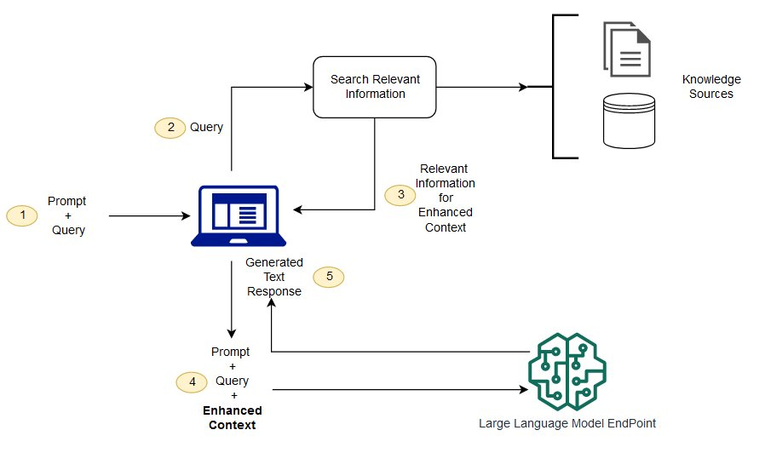
Architecture Diagram
Retrieval augmented architecture diagram
IT21084522 | Dissanayake A. L. | R24-109

Slide 70
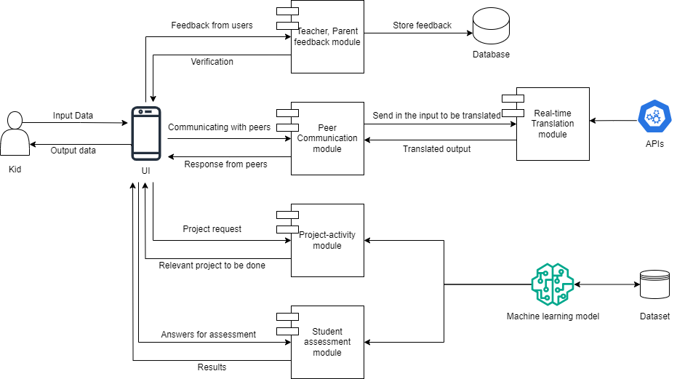
Methodology
System Diagram
IT21084522 | Dissanayake A. L. | R24-109

Slide 71
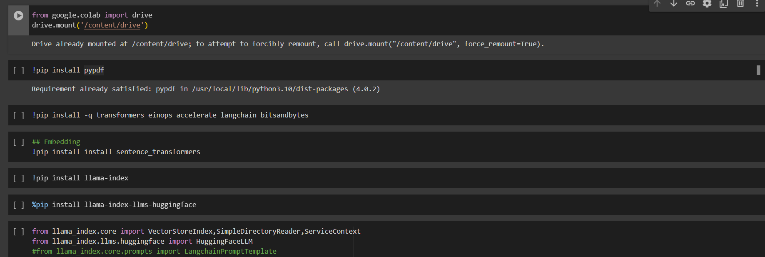
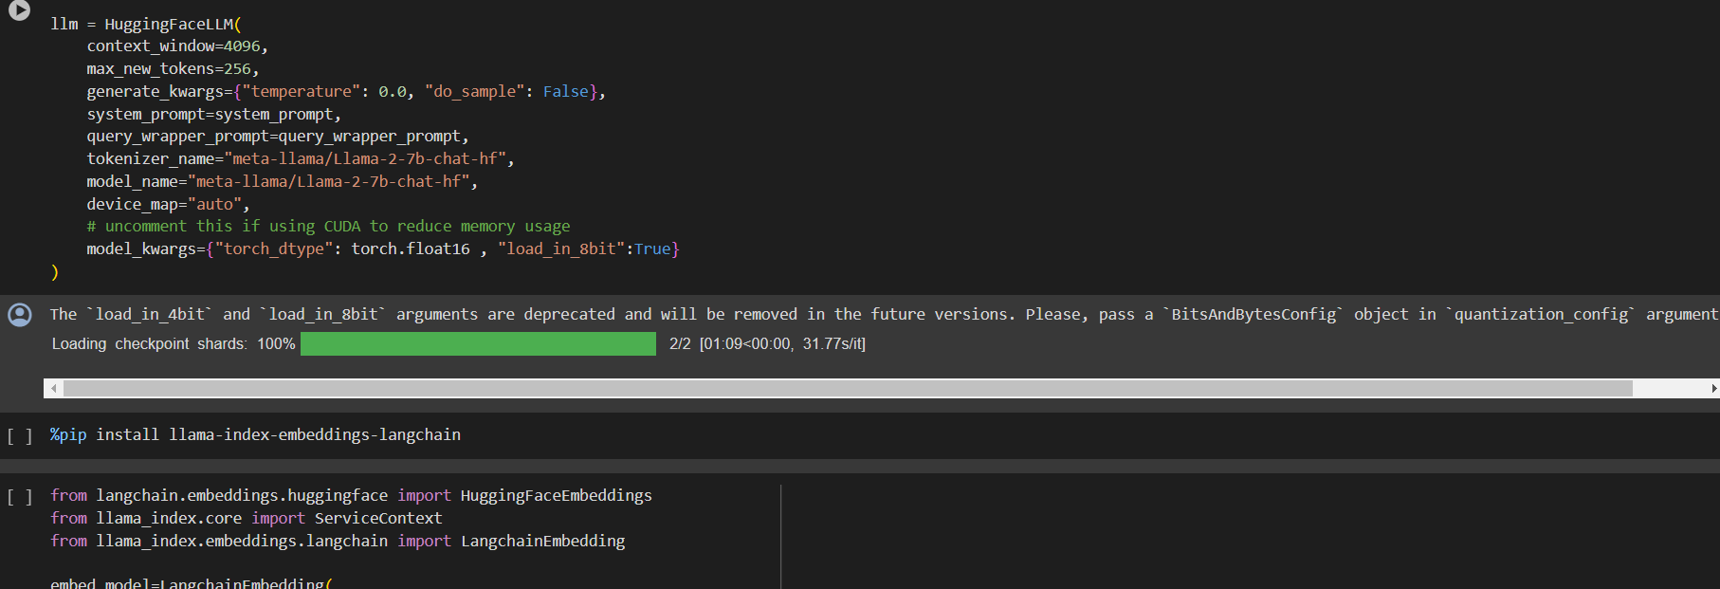
Methodology Cont'd
RGA model
IT21084522 | Dissanayake A. L. | R24-109

Slide 72
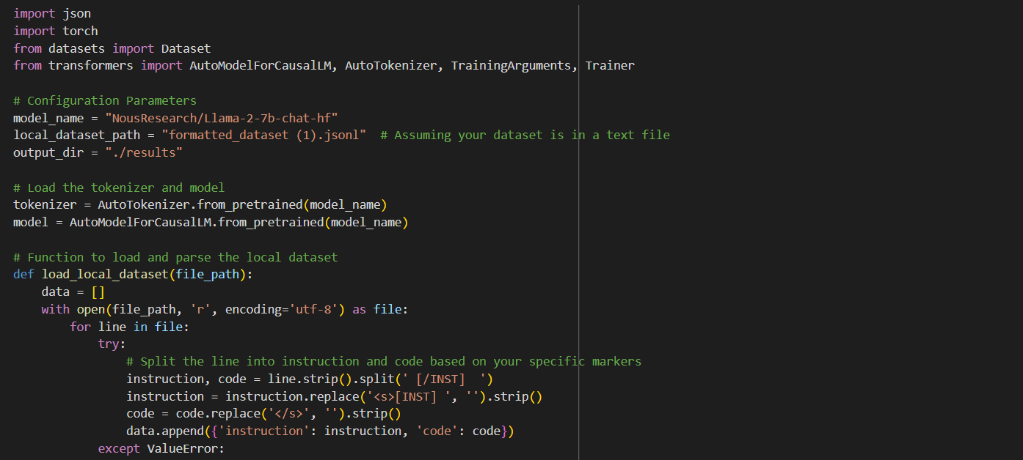
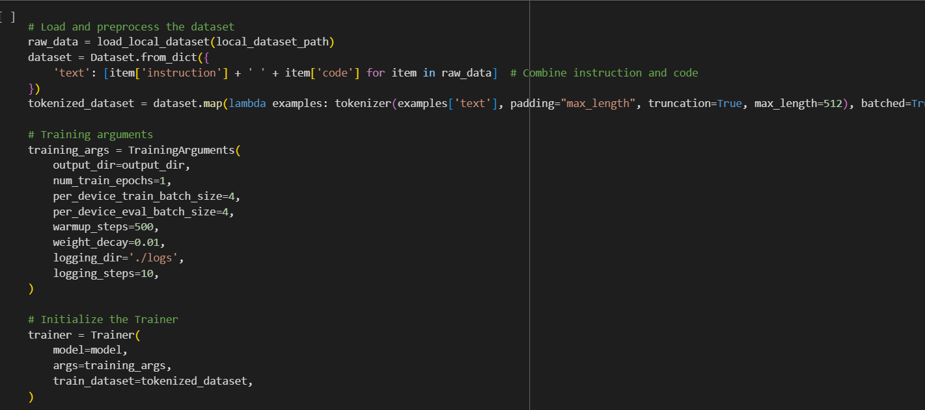
Methodology Cont'd
Fine-tuning Llama
IT21084522 | Dissanayake A. L. | R24-109

Slide 73
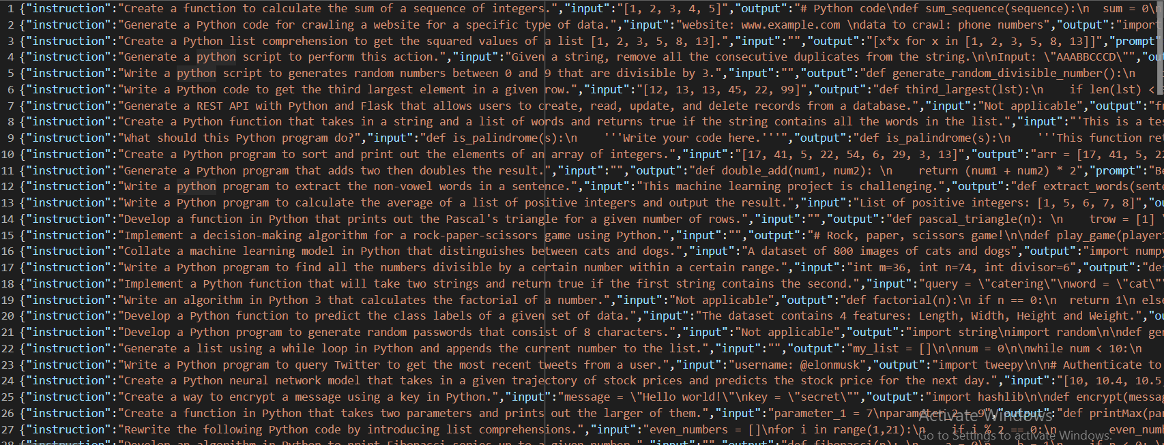
Methodology Cont'd
Model Dataset
IT21084522 | Dissanayake A. L. | R24-109

Slide 74



Methodology Cont’d
Technologies Used
Flutter
Llama
Libraries (PyTorch, Transformers, PEFT)
Microsoft Translator API
React
IT21084522 | Dissanayake A. L. | R24-109

Slide 75
Methodology Cont’d
System Requirements
Functional Requirements | Non-Functional Requirements
User should be able to use project-based learning modules | Usability
User should be able to use real-time language translation | Performance
User should be able to collaborate and communicate with a group of kids | Scalability
User should be able to assess their skills | Security
IT21084522 | Dissanayake A. L. | R24-109

Slide 76

Methodology Cont’d
Challenges
Finding an accurate model
Looking for ways to fine-tune a generalized model
Finding a dataset and collecting data.
Having limited processing power.
Being hard to manage the workload.
IT21084522 | Dissanayake A. L. | R24-109

Slide 77
Methodology Cont’d
Future Plans
Complete Subcomponents
Prototype design
Gathering more data
Start working on the research paper
Finish the overall product
IT21084522 | Dissanayake A. L. | R24-109

Slide 78
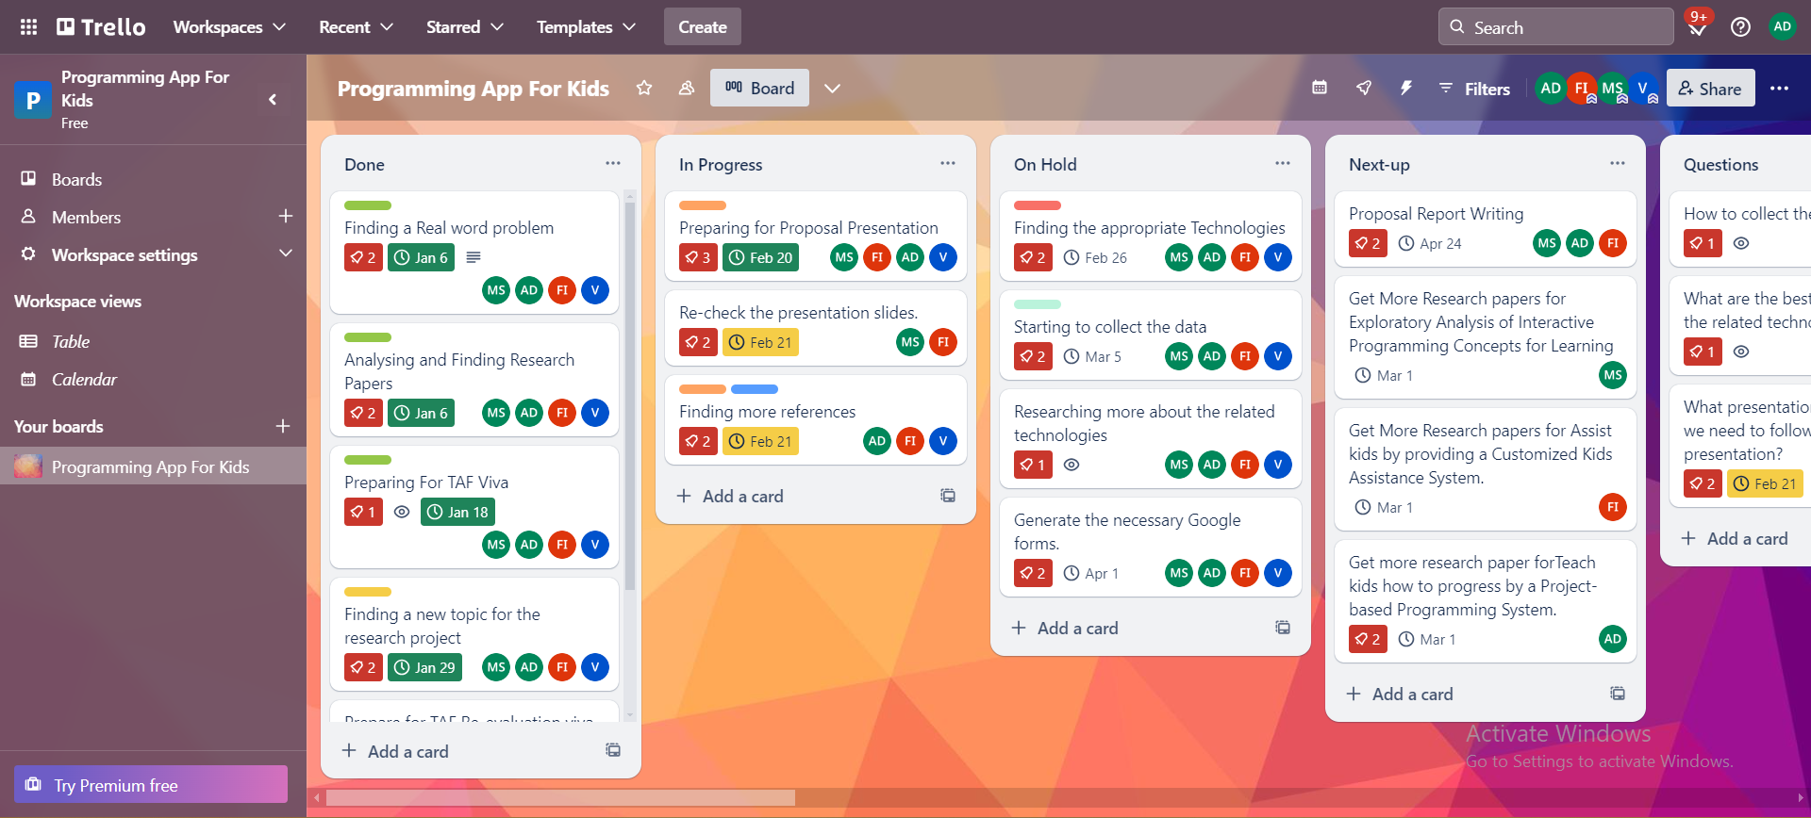
Methodology Cont’d
IT21084522 | Dissanayake A. L. | R24-109

Slide 79
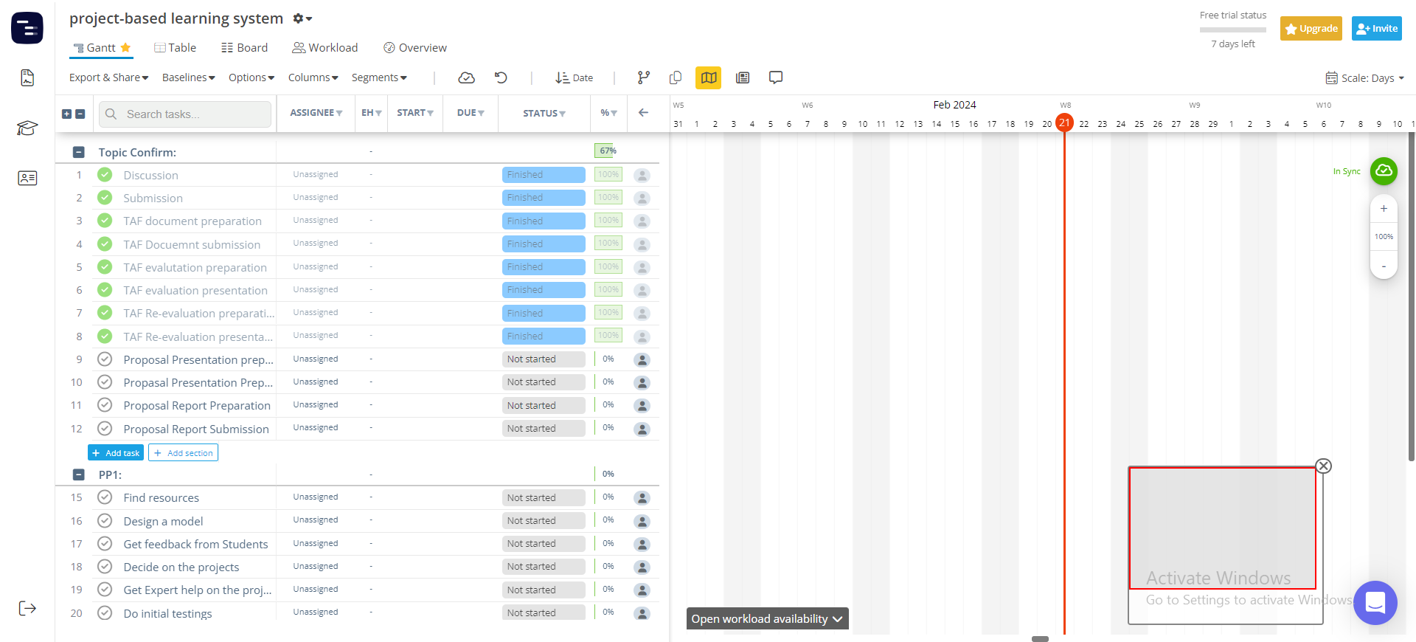
Methodology Cont’d
Gantt Chart
IT21084522 | Dissanayake A. L. | R24-109

Slide 80
Supporting Items
Budget
NO | Expenditure | Cost ($)
1 | Domain | 14.43$/M
2 | Hosting | 2.99$/M
3 | Traveling Expenses (4 Members ) | 12.84$/Trip
4 | Google Play Developer Fee | 25$ (One Time)
Total |  | 55.26$
IT21084522 | Dissanayake A. L. | R24-109

Slide 81
Supporting Items
Commercialization
Offer a subscription-based model
Licensing and Partnerships
Share on social media add
Make it shareable
Provide an accurate description of our product
IT21084522 | Dissanayake A. L. | R24-109

Slide 82
References
[30] “(PDF) Project-Based Learning Approach for teaching mobile application ...,” Project-Based Learning Approach for Teaching Mobile Application Development Using Visualization Technology, https://www.researchgate.net/publication/340901247_Project-Based_Learning_Approach_for_Teaching_Mobile_Application_Development_Using_Visualization_Technology (accessed Feb. 20, 2024).
[31] Author links open overlay panelAslina Saad a et al., “A review of Project-Based Learning (PBL) and Computational Thinking (CT) in teaching and learning,” Learning and Motivation, https://www.sciencedirect.com/science/article/abs/pii/S0023969022000224 (accessed Feb. 21, 2024).
[32] F. Niklas, E. Birtwistle, A. Wirth, T. Schiele, and A. Mues, “App-Based Learning for Kindergarten Children at Home (learning4kids): Study protocol for cohort 2 and the school assessments - BMC pediatrics,” BioMed Central, https://bmcpediatr.biomedcentral.com/articles/10.1186/s12887-022-03737-w (accessed Feb. 21, 2024).
IT21084522 | Dissanayake A. L. | R24-109

Slide 83
References
[1] https://www.bbc.com/news/world-61028138
[2] https://www.ncbi.nlm.nih.gov/pmc/articles/PMC9212225/
[3] https://icts.io/2023/09/08/top-3-outsourcing-countries-in-asia-india-philipines-and-vietnam
[4] https://timesofindia.indiatimes.com/india-fastest-growing-open-source-contributor-github/articleshow/81741376.cms?from=mdr

Slide 84
Thank-You

